Slide 1

Modeling of SAR-Derived Displacement Mean Velocity over Etna Using Bilinear Splines and Least Squares Collocation
A case study on the northeastern flank of Mount Etna (2019–2023)
(2D Splines + Least Square Collocation)
Wenlei Yang
Student ID: 259732
Professors: Giovanna Venuti; Mirko Reguzzoni
Geospatial Data Analysis A.A. 2024/2025

Slide 2
Index
01 - Workflow
02 - Data Collection
03 - Polynomial Trend Surface Modeling
04 - Bilinear Spline Interpolation
05 - Collocation Modeling (LSC)
06 - Model Evaluation and Interpretation

Slide 3
01 - Workflow | Methodological Flowchart
Data Collection
Polynomial Trend Surface Modeling
▪ Least squares fitting of a 2nd-order polynomial
▪ Parameter significance testing
▪ Model diagnostics (χ² test, residuals)
Bilinear Spline Interpolation
▪ geoSplinter-based spline modeling
▪ Regularization and λ tuning
▪ Iterative outlier removal
▪ Spline residual analysis and TIN visualization
Collocation Modeling (LSC)
▪ Empirical covariance estimation
▪ Covariance model fitting (exponential model)
▪ Least Squares Collocation over polynomial trend
▪ Error variance
Model Evaluation and Interpretation
Notes:
This combination allows me to separate large-scale deterministic deformation from small-scale correlated stochastic deformation.

Slide 4
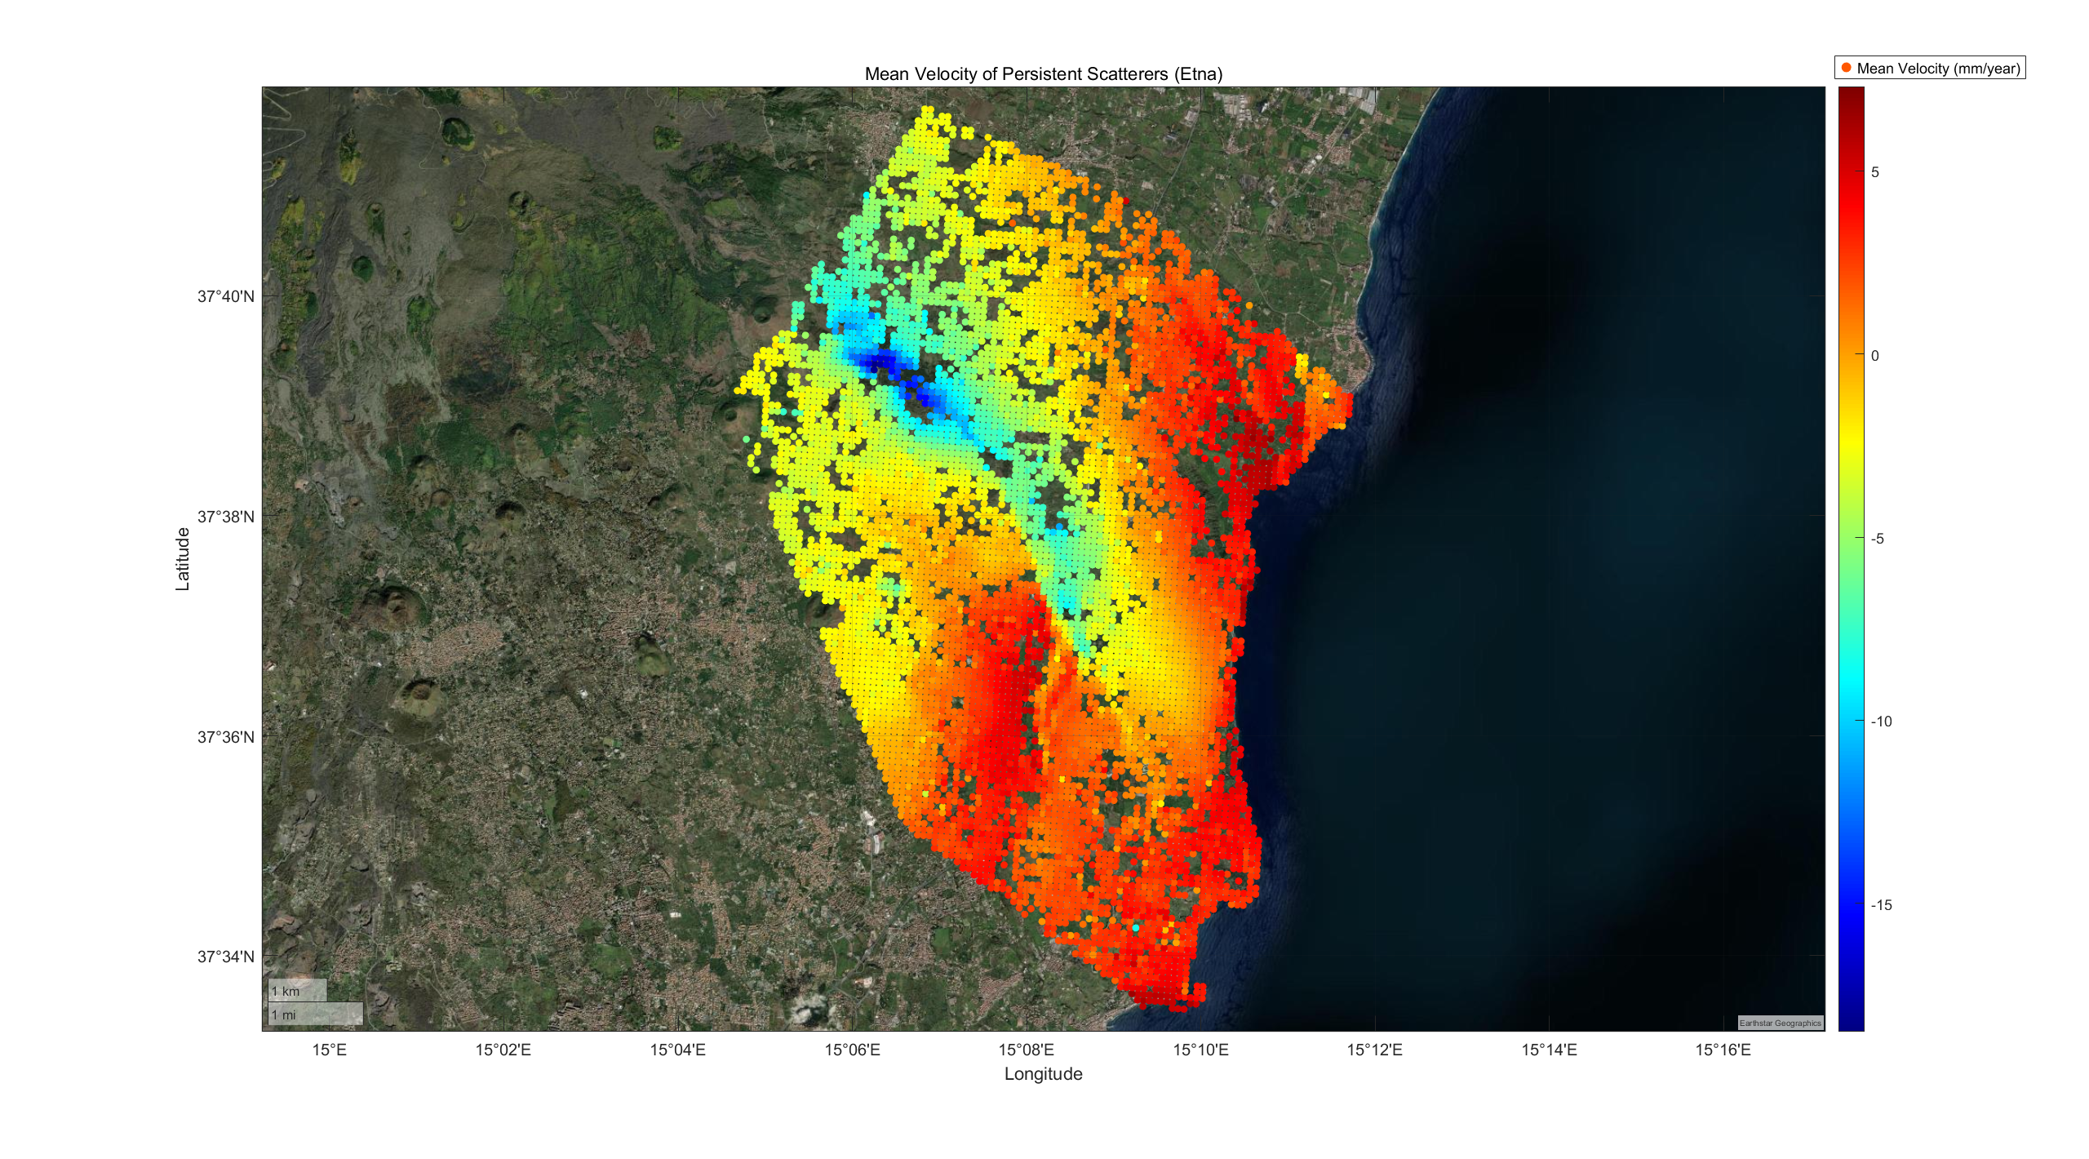
02 - Data Collection
Data Description
Location: Southeastern flank of Mt. Etna, Sicily (Italy)
Number of Persistent Scatterers: 7332
Observation Period: January 2019 – October 2023 (~5 years)
Unit: Displacement velocity [mm/year]
Observation Type: Mean Vertical Velocity from PS-InSAR
Area:
[min(lat), max(lat)]: [37.5586, 37.6949]
[min(lon), max(lon)]: [15.0780, 15.1952]
Dim(x) = 10,338 meters
Dim(y) = 15,120 meters
Fig.01 Mean Velocity of Persistent Scatterers (Etna)

Slide 5
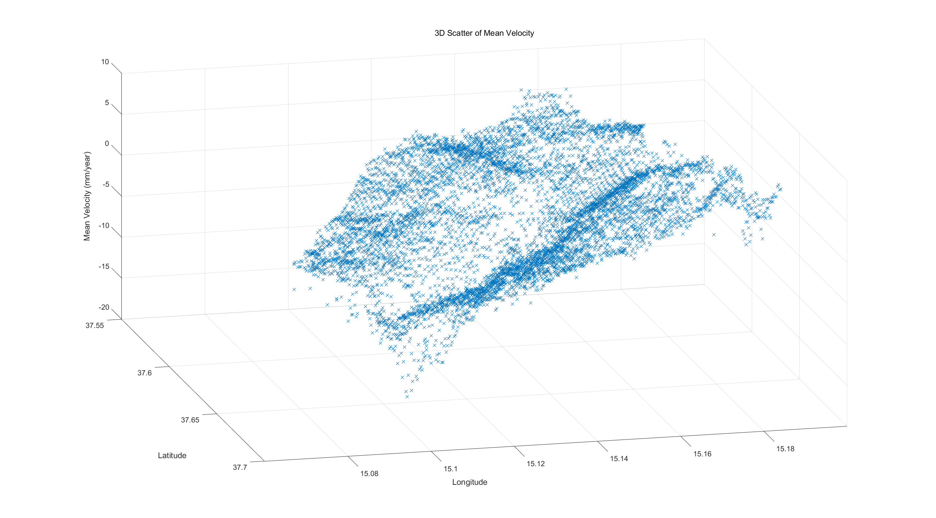
02 - Data Collection
Data Description
General Pattern:
1. Significant spatial deformation gradient
Vertical motion is unevenly distributed across the area, revealing a clear deformation gradient.
2. Distinct long-term subsidence and uplift
The data show persistent vertical ground displacement trends, with widespread uplift (red/orange) near the eastern coast and subsidence (blue) in the central-western part.
3. Localized deformation center
A concentrated subsiding zone in the west-central region suggests active tectonic or gravitational instability processes.
Fig.02 3D Scatter of Mean Velocity
Notes:
长期下沉与隆起现象明显存在显著的空间形变梯度 地表垂向运动在整个区域内分布不均，表明形变在空间上具有明显的梯度变化。 数据揭示出明显的垂向地表形变趋势：东部沿海区域表现为广泛的地表隆起（红色/橙色），而中西部区域则存在剧烈的地表下沉（蓝色）。
形变中心局部集中 西部中部的强烈下沉区形成了一个局部的形变中心，可能与构造活动或地形重力不稳定性有关。
We can see a significant spatial deformation gradient: uplift dominates in the east near the coast, while a subsidence center is located in the west-central part.This shows both long-term tectonic processes and localized instabilit

Slide 6
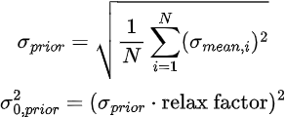
02 - Data Collection
Define A-priori Variance
Pirori Standard Deviation: s0_apr =0.4455 (mm/yr)
Priori Variance: s02_apr = 0.3355 (mm/yr)²
^{(relax factor = 1.3)}
Notes:
s_teacher = sqrt(mean((mean_vel_std).^2)); % mm/year
average the variance, and the compute the square root of variance
s02_apr = (s_teacher * 1.3)^2 % mm²

Slide 7
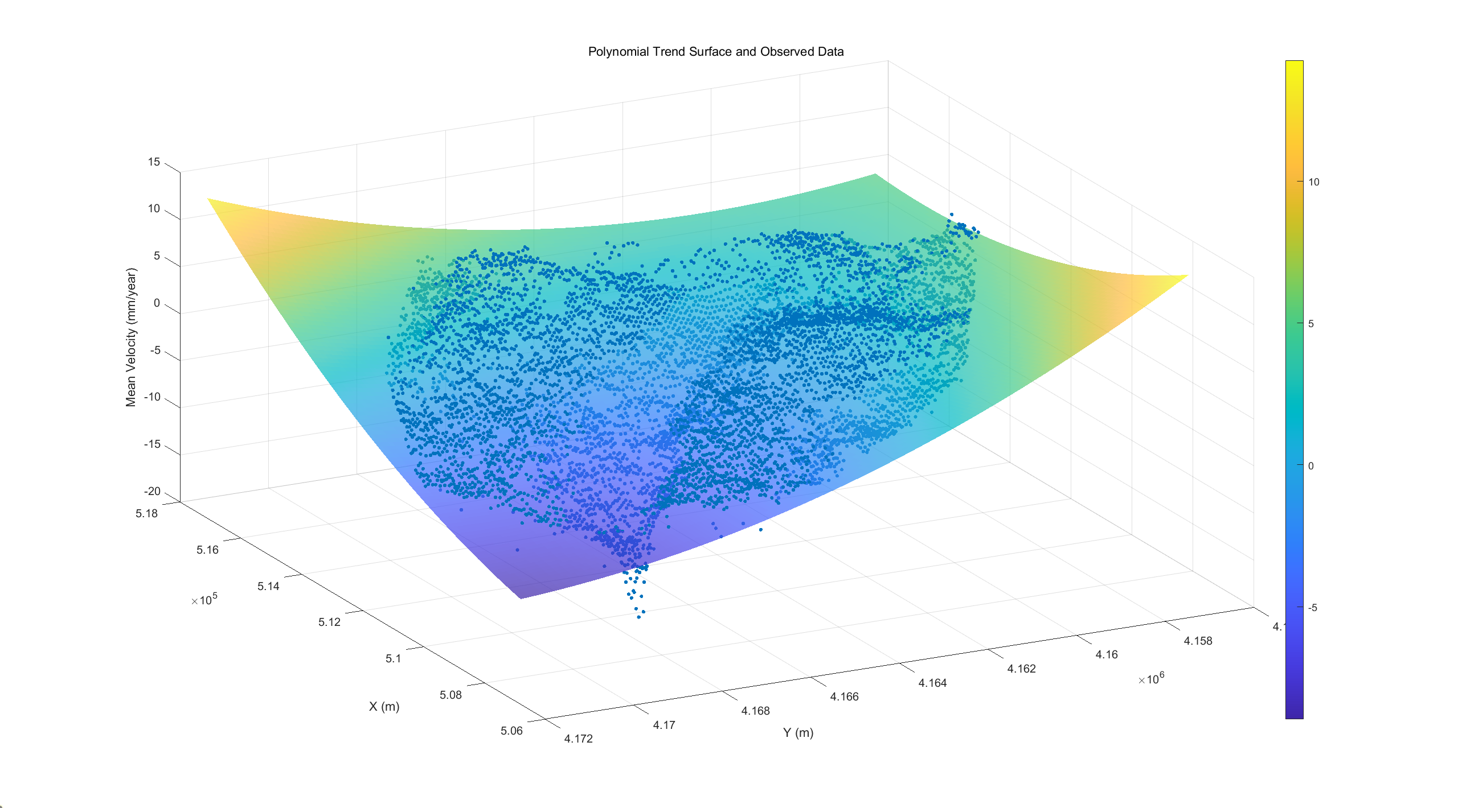
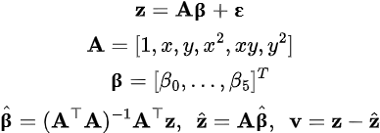
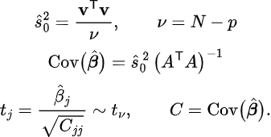
03 - Polynomial Trend Surface Modeling
2D Quadratic Polynomial Model
T-test Significance
Fig.03 Initial Quadratic Polynomial Trend Surface and Observed Data
t_{obs} |  |  |  |  |  | t_{lim}
𝛽₀ | 𝛽₁ | 𝛽₂ | 𝛽₃ | 𝛽₄ | 𝛽₅
40.6536 | 48.0266 | 37.7207 | 22.9009 | 45.8512 | 34.4884 | 1.9603
Keep all the parameters
Chi-Square test: X²_{obs}: 14.7357
(X²_{lim_inf}: 0.9679, X²_{lim_sup}: 1.0326)
Notes:
I tested a cubic trend, but in UTM meter coordinates the x, x², x³ terms blow up in scale, which makes the design matrix ill-conditioned. That inflates the coefficient standard errors, so the t-values collapse toward zero—it’s a numerical issue, not physics. Statistically, the cubic terms didn’t bring a meaningful improvement and the overall χ² got worse, so I kept a quadratic trend for the large-scale gradient/curvature and modeled the fine-scale, anisotropic structure with splines/LSC, which is the right division of labor here.

Slide 8
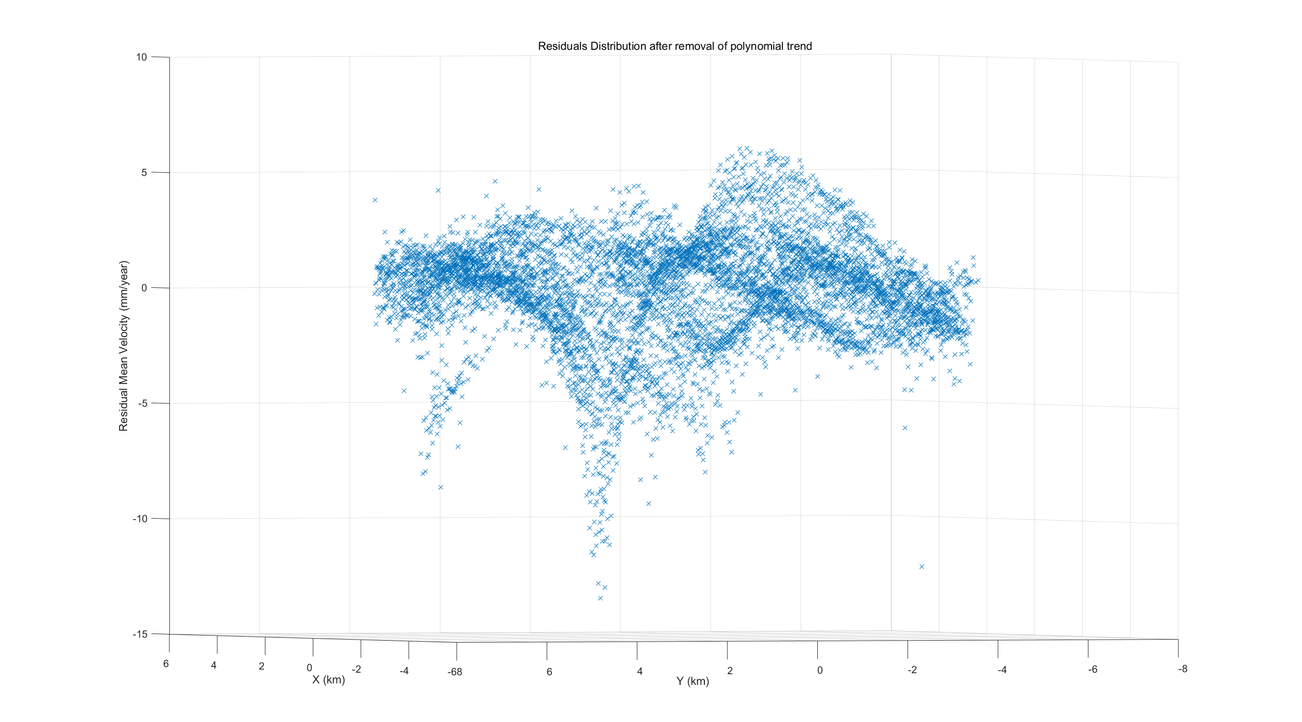
03 - Polynomial Trend Surface Modeling
Polynomial Trend Removal
The residuals exhibit localized structural patterns, with a notable belt of negative residuals (subsidence) extending across the central and edges of the area. This suggests that the 2nd-order polynomial model fails to fully capture these spatial variations.
Fig.04 Residuals Distribution after Removal of Polynomial Trend
Notes:
“I tested a cubic trend, but in UTM meter coordinates the x, x², x³ terms blow up in scale, which makes the design matrix ill-conditioned. That inflates the coefficient standard errors, so the t-values collapse toward zero—it’s a numerical issue, not physics. Statistically, the cubic terms didn’t bring a meaningful improvement and the overall χ² got worse, so I kept a quadratic trend for the large-scale gradient/curvature and modeled the fine-scale, anisotropic structure with splines/LSC, which is the right division of labor here.”
After removing the 2nd-order polynomial trend, the residual velocities reveal localized subsidence patterns and surface fluctuations not captured by the global model, suggesting the need for higher flexibility (e.g., spline or collocation models) to fully describe spatial deformation variability.
A quadratic trend is sufficient to capture the large-scale gradient/curvature. The remaining, clearly fine-scale, anisotropic structure is better handled by splines/LSC, which is exactly what I use next. Raising polynomial order here adds numerical instability without meaningful gain.

Slide 9
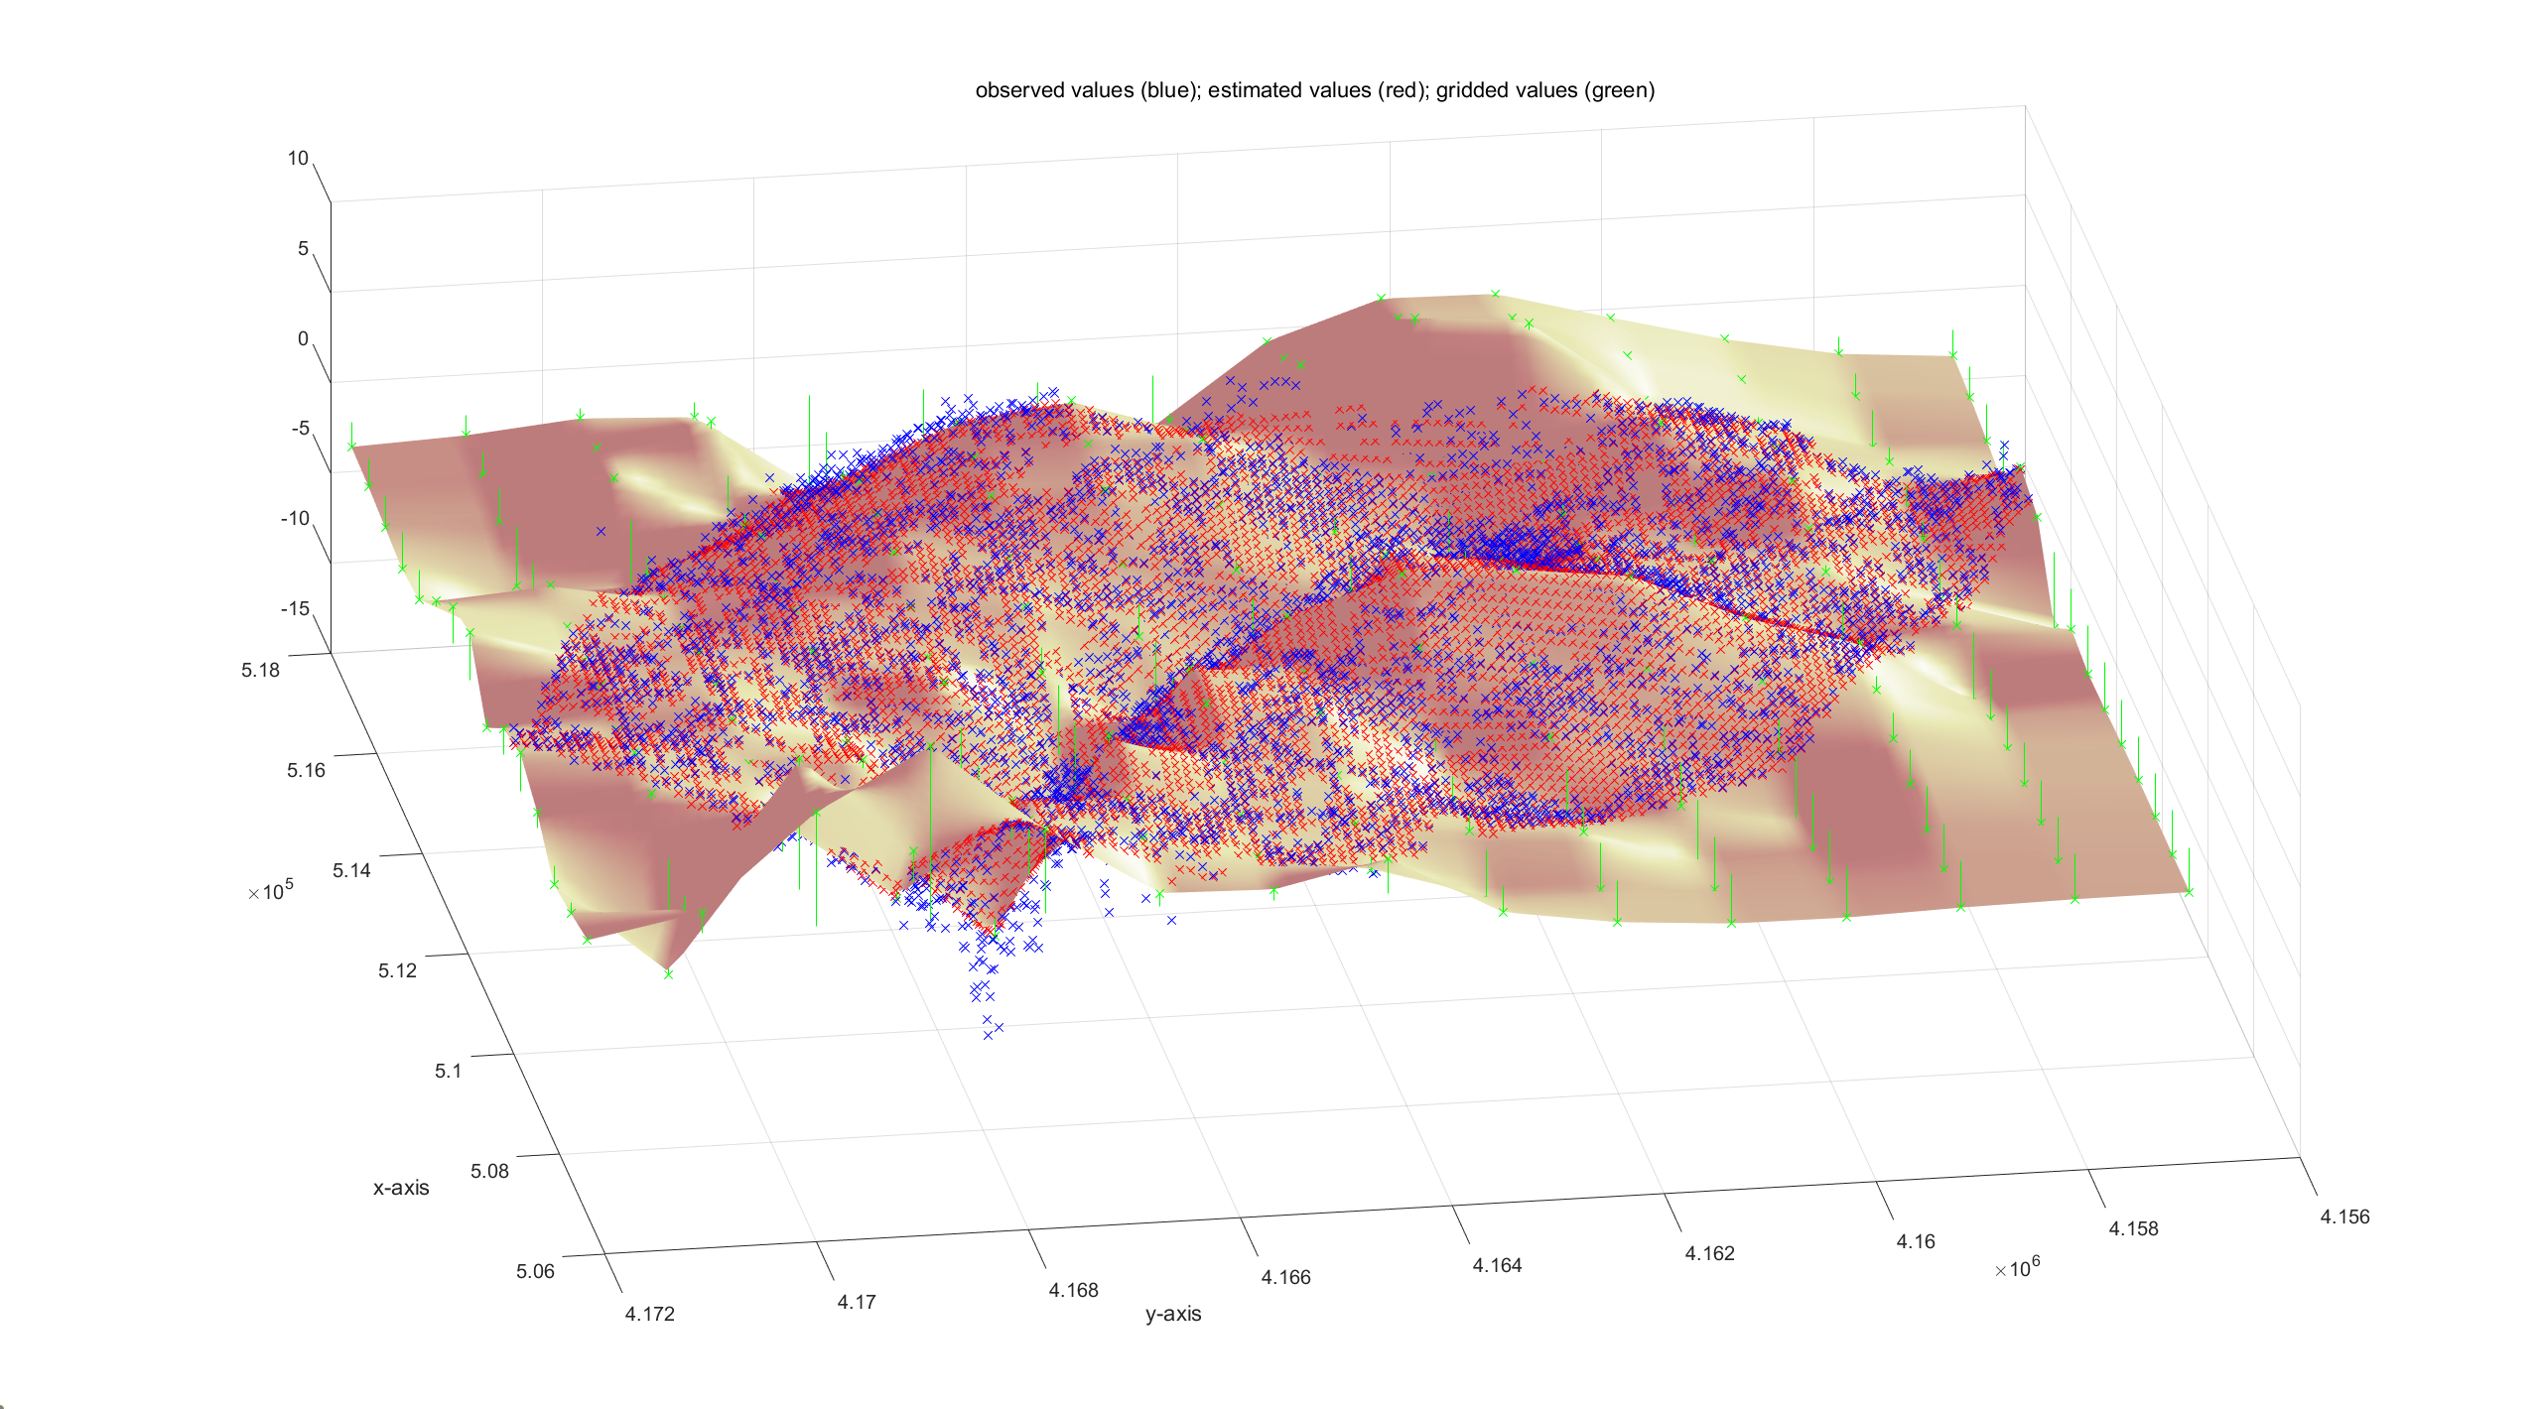
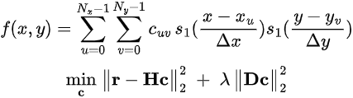
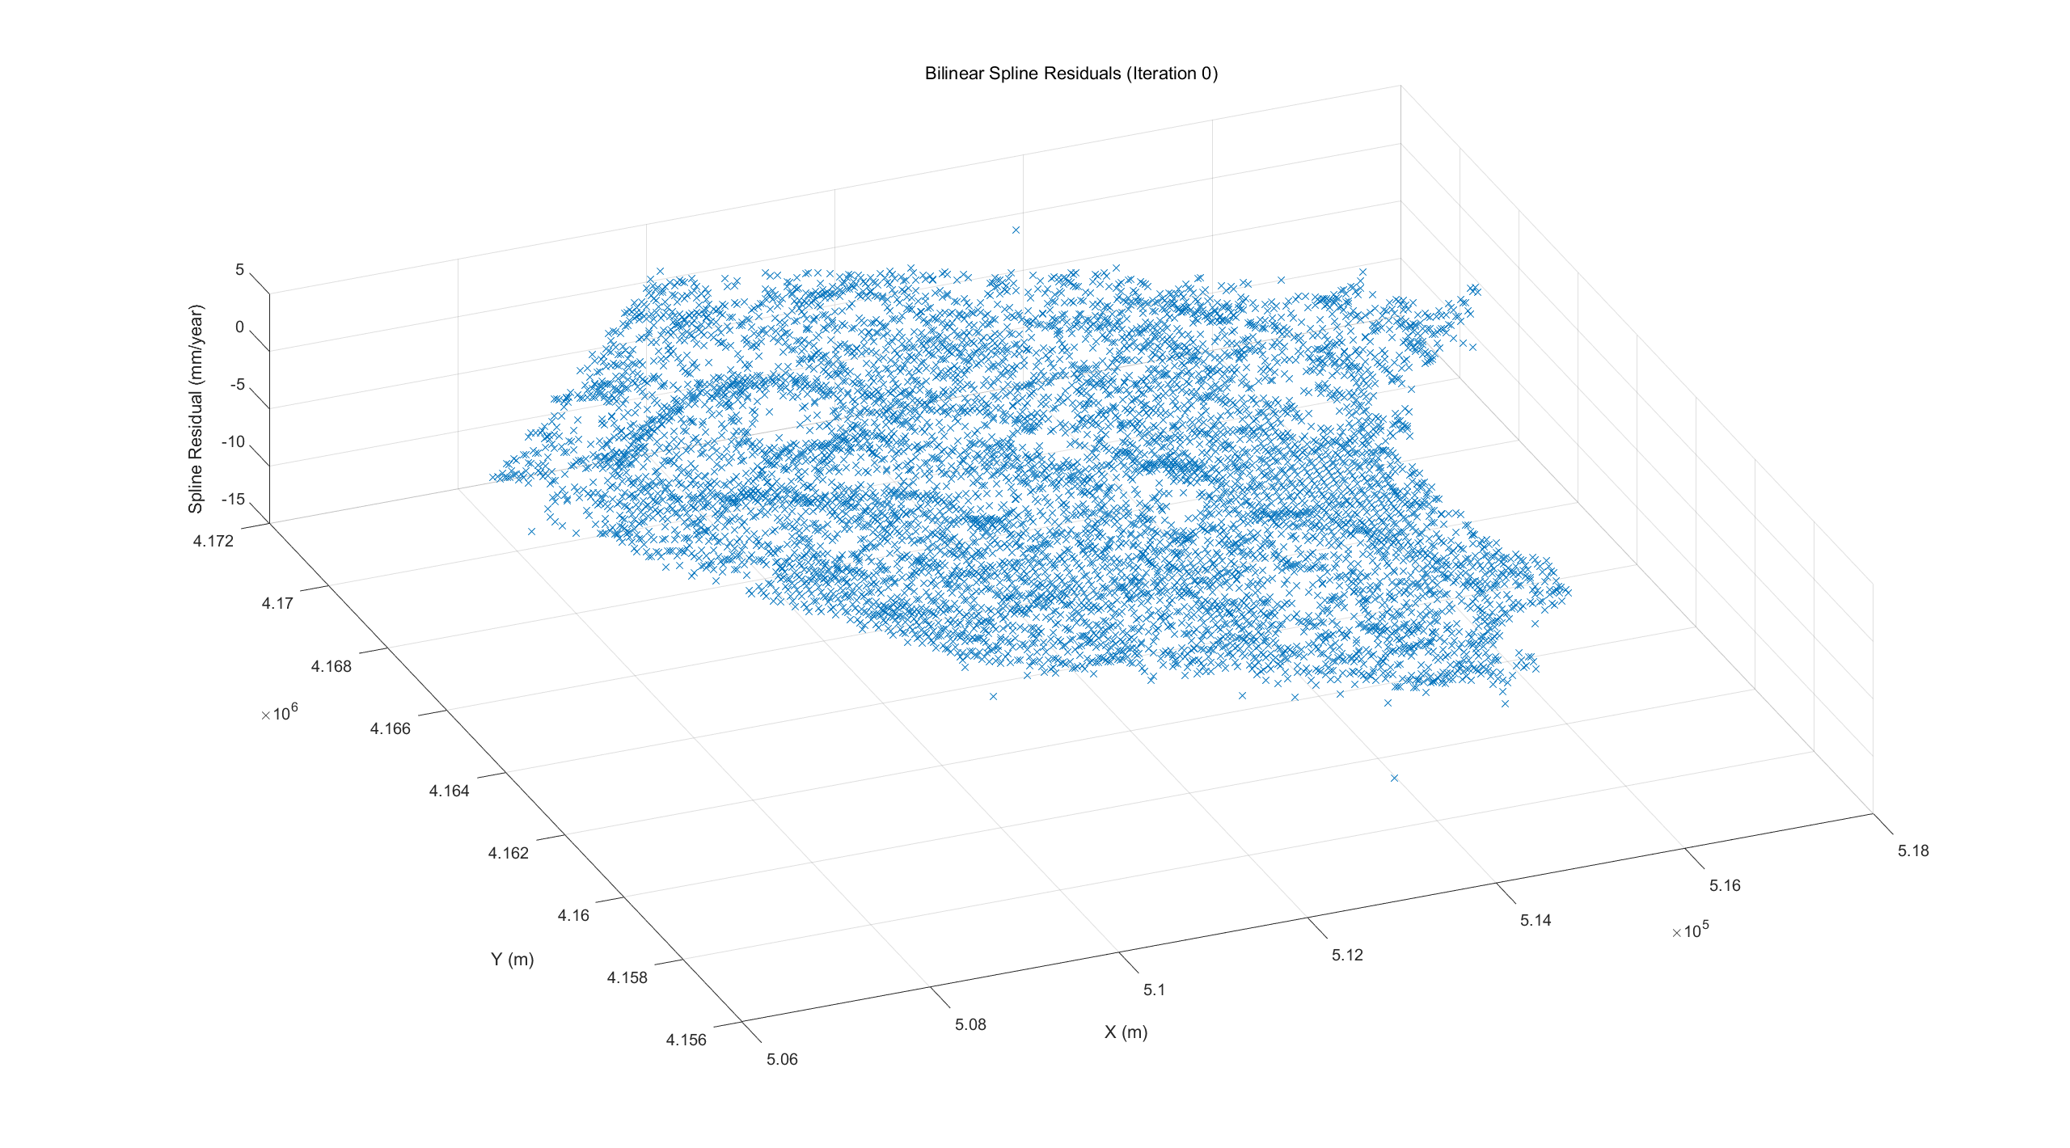
04 - Bilinear Spline Interpolation of Residuals
geoSplinter
First Spline it.0
Setting nodes
Num of Spline Nodes in y: 15, resolution: ~700m
Num of Spline Nodes in x: 15, resolution: ~1km
Lambda λ = 0.0048
Chi Square Test
X²_{obs}= 2.4015
(X²_{lim_inf}: 0.9674, X²_{lim_sup}: 1.0331)
Fig.05 First Interpolation of Spline
Notes:
lambda is a smoothness penalty
= ( the esitimated sigma / the roughly variation in delta observed from the dataset)
(s02_apr/delta^2)
where $D$is a first/second-difference operator. The regularization λ is initialized from the a-priori variance, grid spacing, and the residual gradient scale, then validated via a χ² test and residual diagnostics.”

Slide 10
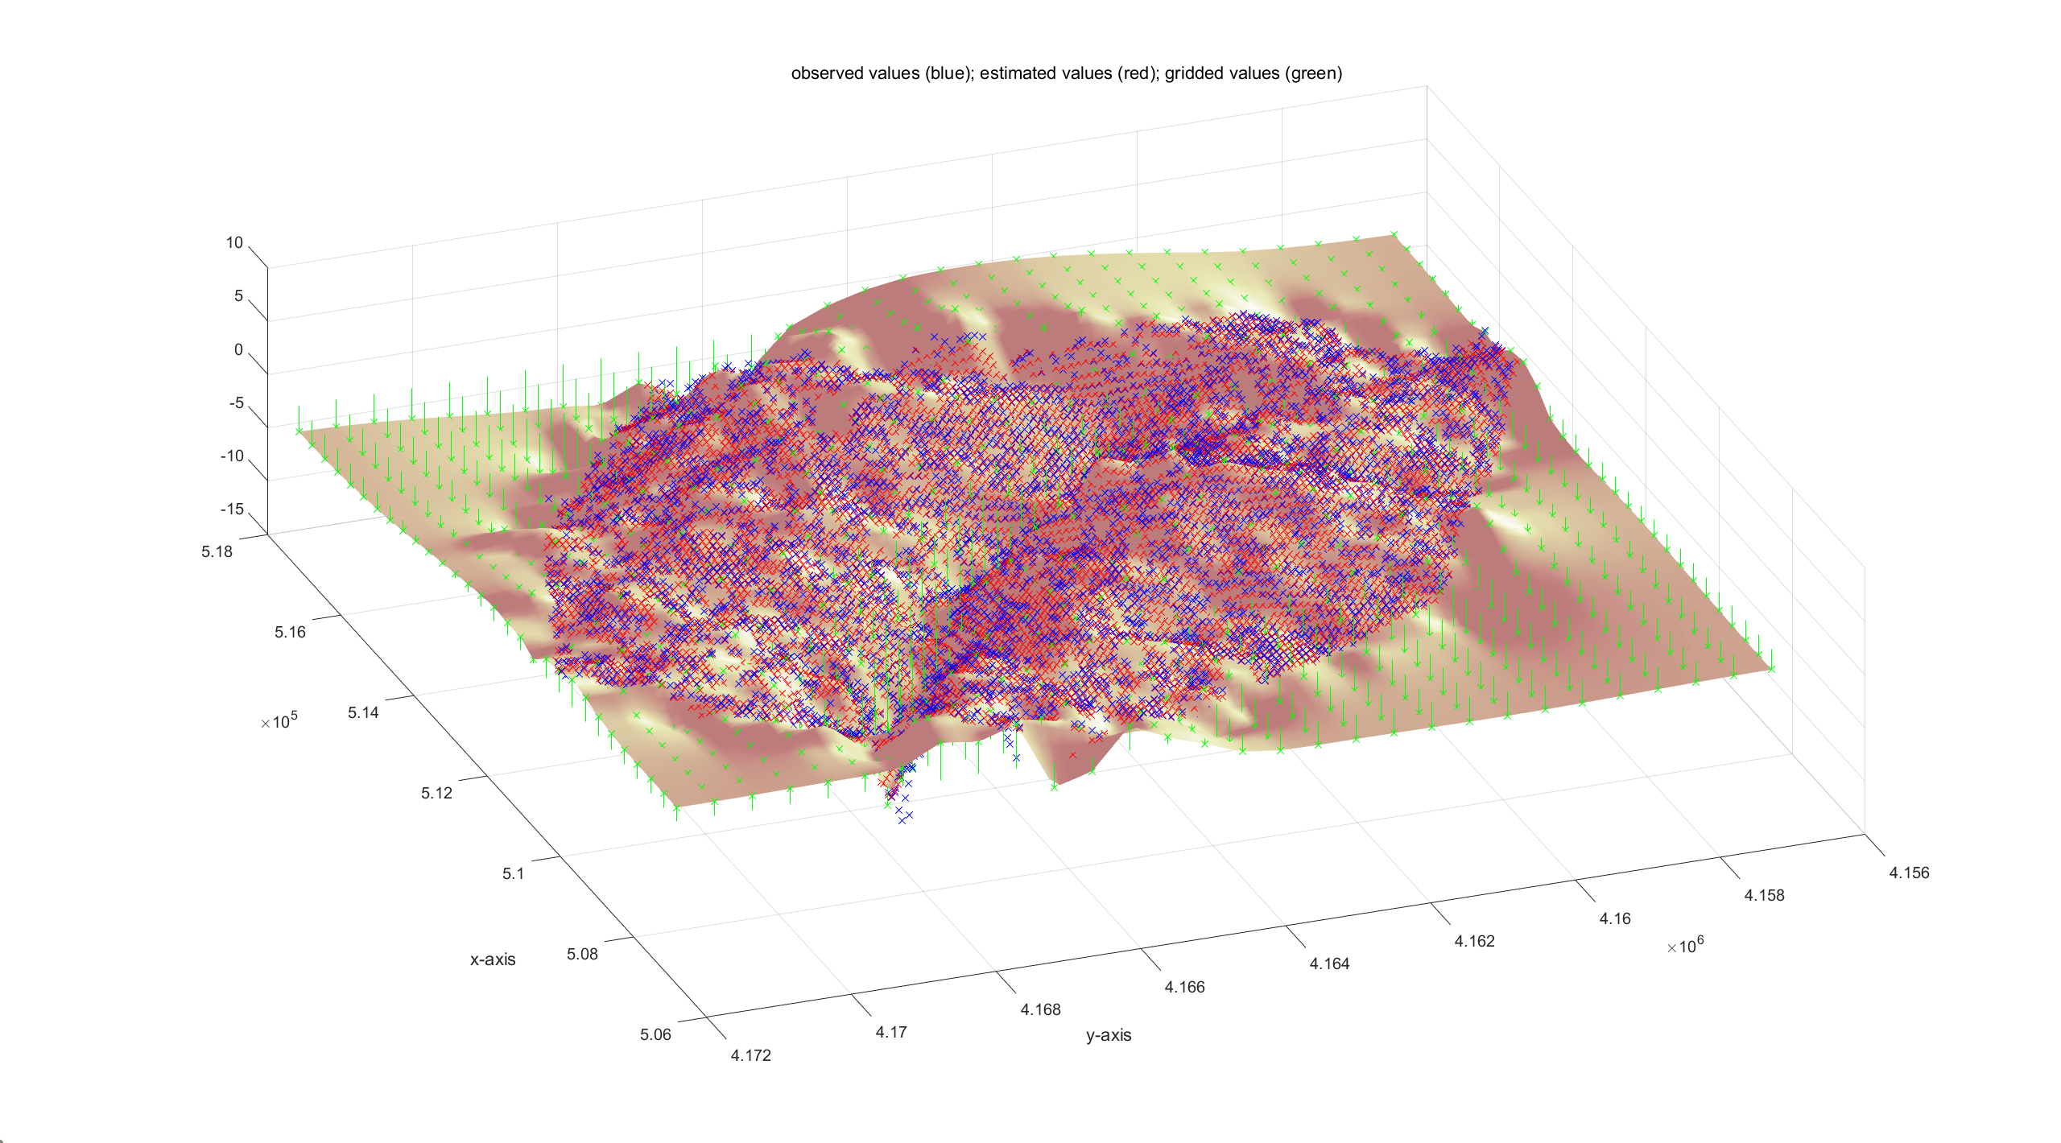
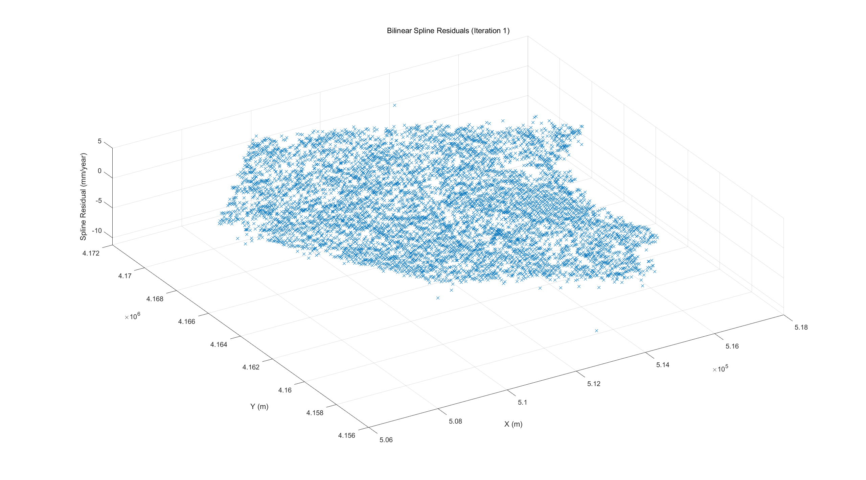
04 - Bilinear Spline Interpolation
First Spline it.1
Setting nodes
Num of Spline Nodes in y: 30, resolution: ~350m
Num of Spline Nodes in x: 30, resolution: ~500m
Lambda λ = 0.0206
Chi Square Test
X²_{obs}= 1.4695
(X²_{lim_inf}: 0. 9657, X²_{lim_sup}: 1.0349)
Fig.06 Second Interpolation of Spline
Notes:
lambda = ( the esitimated sigma / the roughly variation in delta per 1km observed from the dataset)
(s02_apr/delta^2)

Slide 11
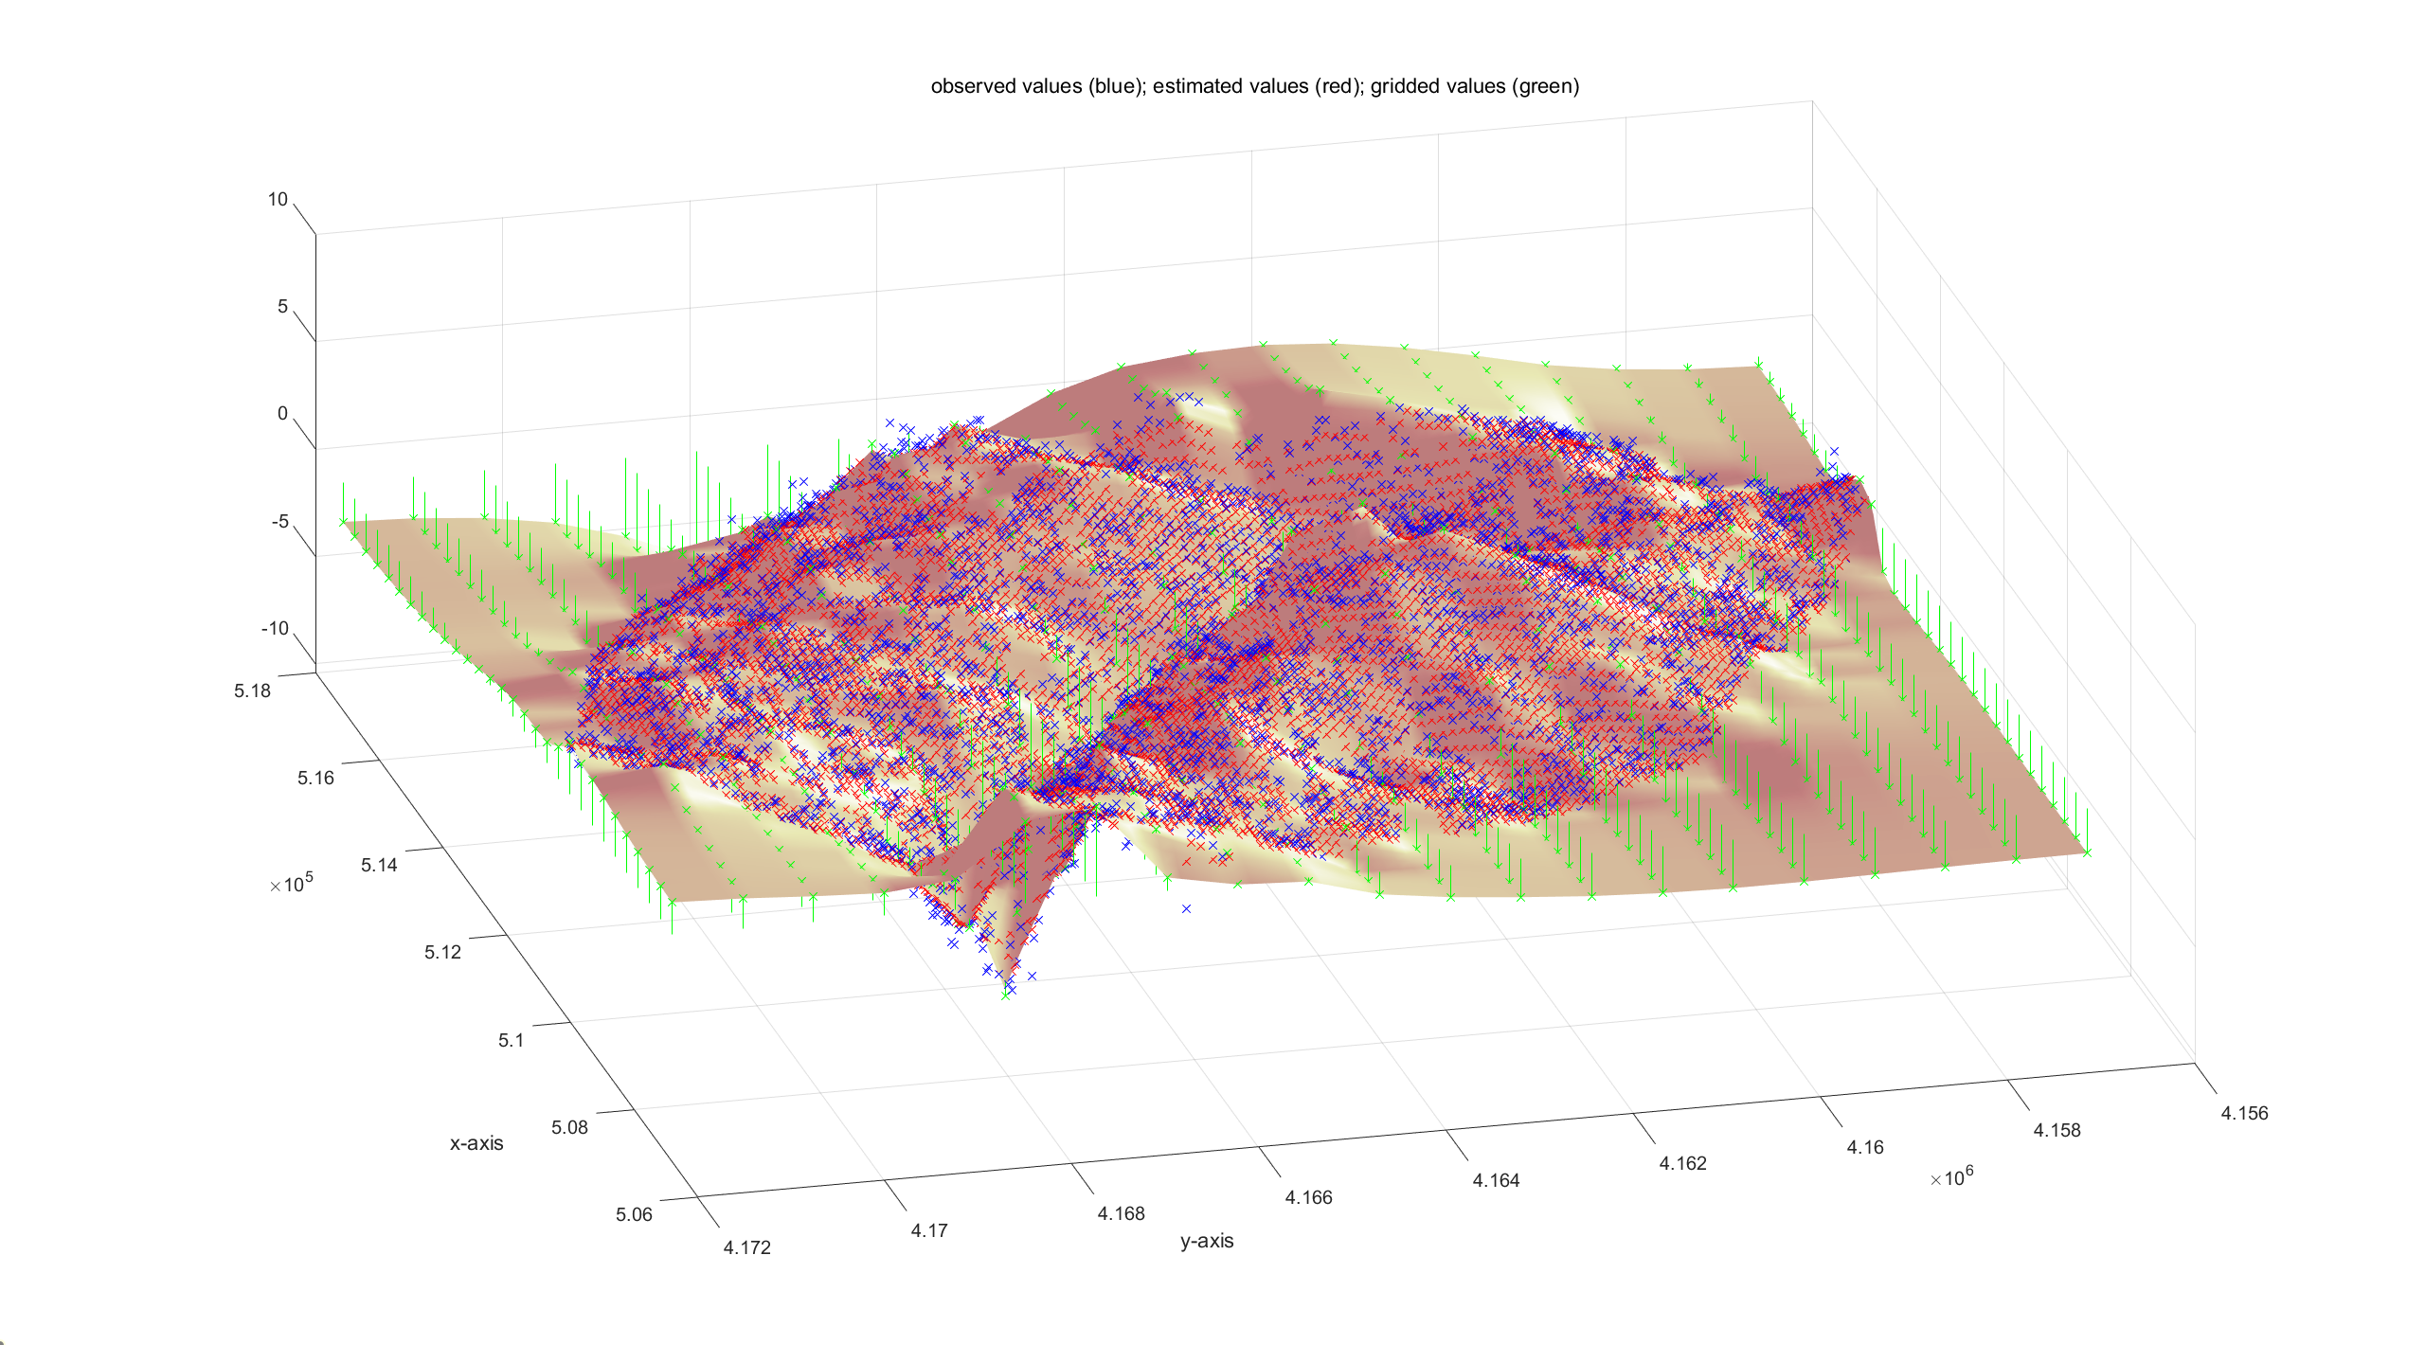
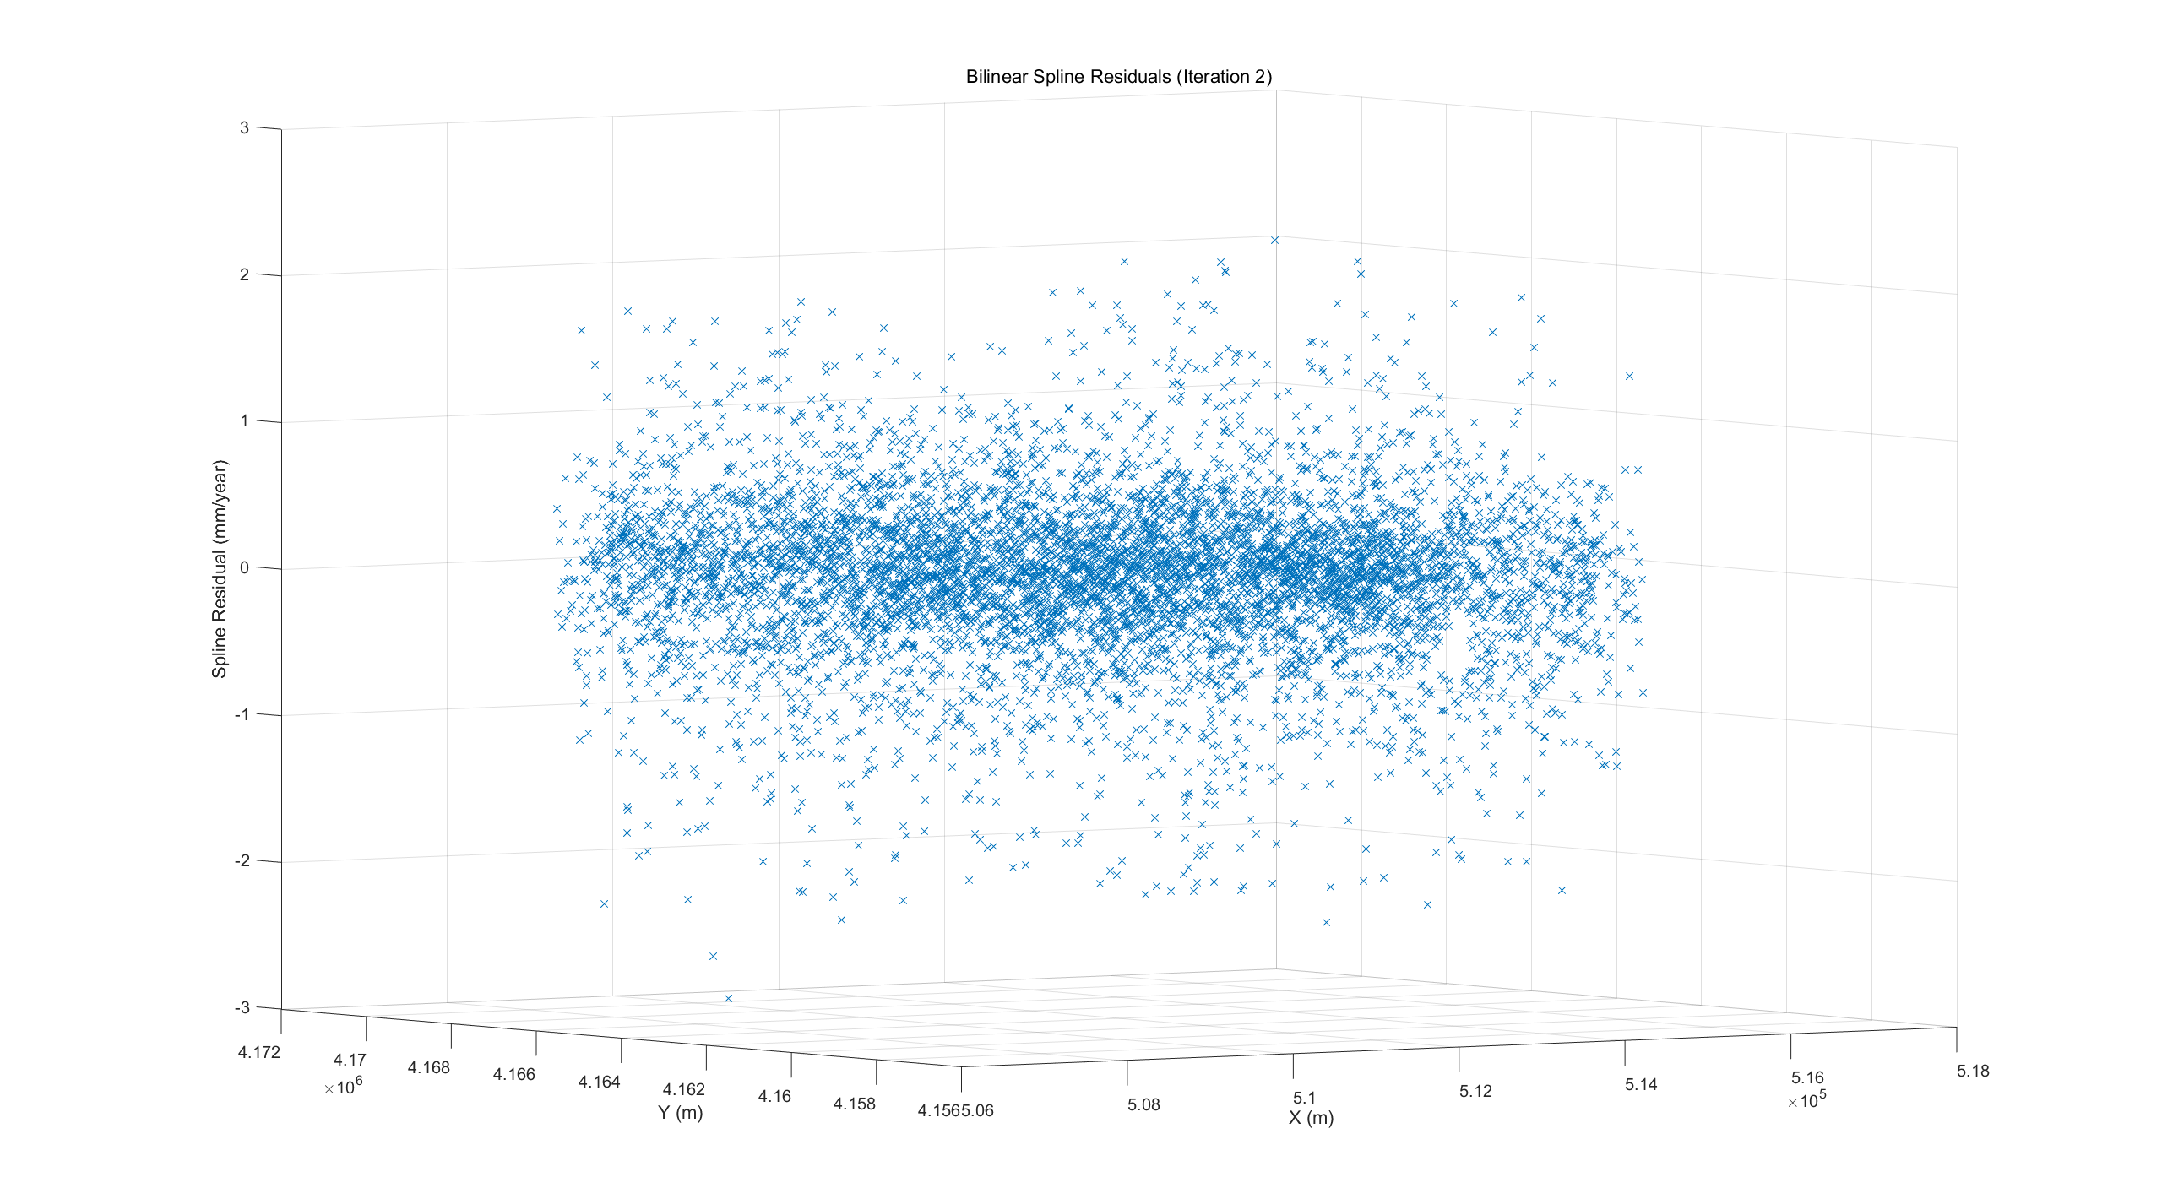
04 - Bilinear Spline Interpolation
Removal of Outliers
μ > 4σ_est；7332- 7284
Num of Spline Nodes in y: 30, resolution: ~350m
Num of Spline Nodes in x: 30, resolution: ~500m
Lambda: 0.0190
Chi Square Test
Test on splines model (it. 3), X^2_obs: 1.4169 (X^2_lim_inf: 0.9663, X^2_lim_sup: 1.0343)
Removal of Outliers
μ > 3σ_est； 7284- 7150
Num of Spline Nodes in y: 30, resolution: ~350m
Num of Spline Nodes in x: 30, resolution: ~500m
Lambda: 0.0190
Chi Square Test
Test on splines model (it. 4), X^2_obs: 0.9533 (X^2_lim_inf: 0.9660, X^2_lim_sup: 1.0346)
Fig.07 Third Interpolation of Spline
Notes:
I first identified the points whose residuals exceeded four times the estimated residual standard deviation, and then iteratively tightened the threshold.”“Initially, I flagged observations with residuals greater than 4σ, and then gradually tightened the criterion in subsequent iterations.”“Outliers were first detected using a 4σ rule; the threshold was then iteratively reduced to refine the cleaning “After the second outlier removal the normalized chi-square fell slightly below the lower bound (0.953<0.966), meaning the residual variance is a bit smaller than our a-priori noise. This is expected after aggressive cleaning. We can either accept it—as the deviation is only ~1%—or raise λ by ~10% (or re-estimate the a-priori variance on the cleaned set) to bring $χ^{2}$back to ~1.”

Slide 12
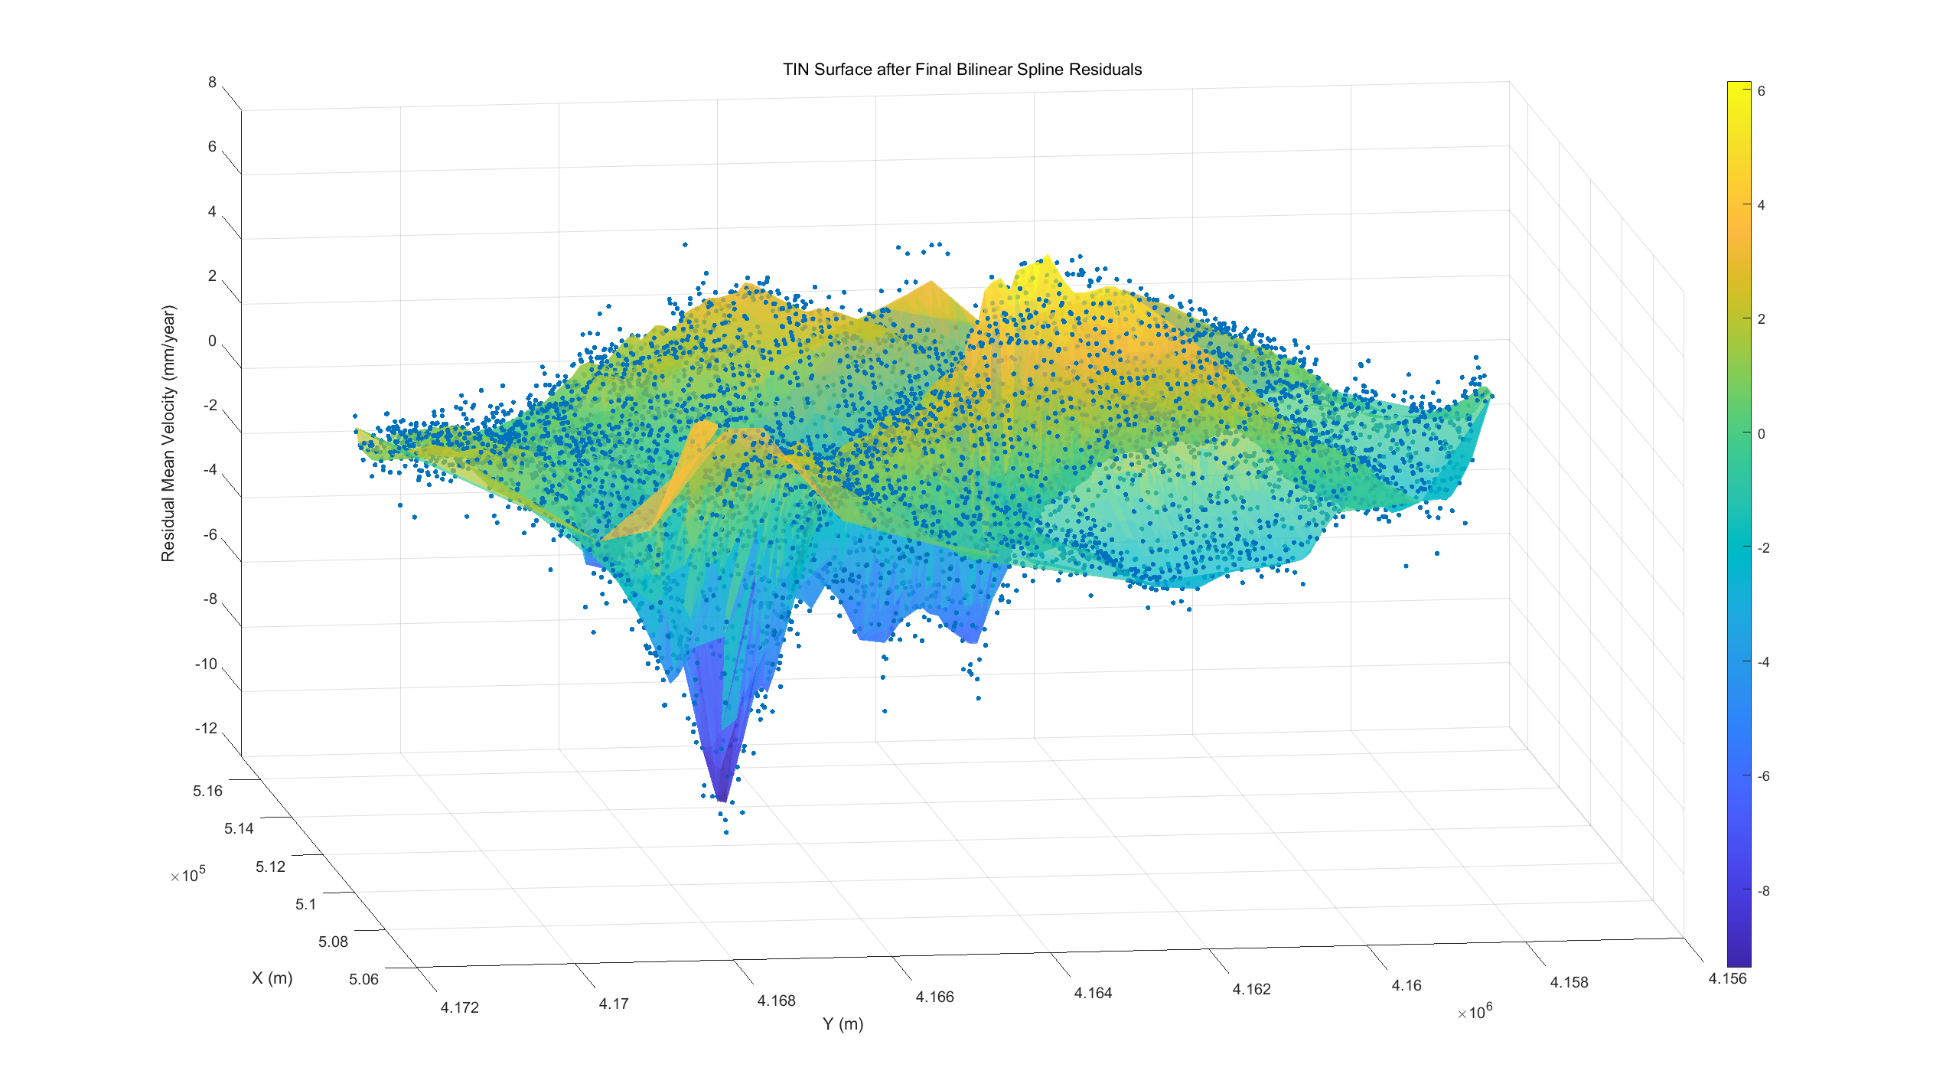
04 - Bilinear Spline Interpolation
Decrease the relax factor
A-priori Variance : 0.32
Chi Square Test
Test on splines model (it. 2), X^2_obs: 0.9995 (X^2_lim_inf: 0.9660, X^2_lim_sup: 1.0346)
Fig.08 TIN Surface after Final Bilinear Spline Residuals
Notes:
the estimated variance of the residuals
Points exceeding this threshold are considered outliers and removed from the dataset.

Slide 13
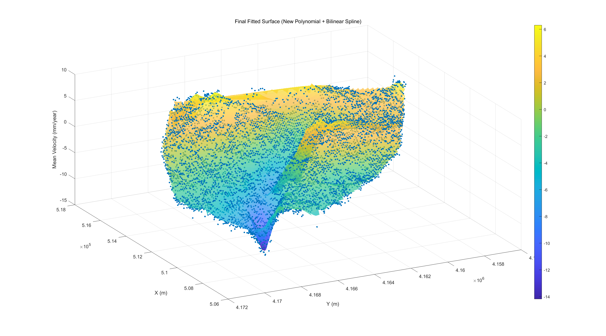
04 - Bilinear Spline Interpolation
Re-estimate the polynomial trend (after removing outliers)
Covariance Propagation of Estimated Trend
Cyy_est = A * Cxx_est * A';
Fit with Polynomial + Spline
Save the polynomial model for Collocation
save('Etna_spline_output_cleaned.mat', ...
'x_sort3', 'y_sort3', ...
'z_in', ... % displacement after outlier removal
‘ y_est_fin', ... % polynomial surface after re-fitting
'best_res_epc', ... % spline residuals
'displ_fin', ... % final modeled field
'res_poly', ... % residuals after new polynomial
'Cyy_est'); % covariance matrix for LSC
Fig.09 Final Fitted Surface (New Polynomial + Bilinear Spline)

Slide 14
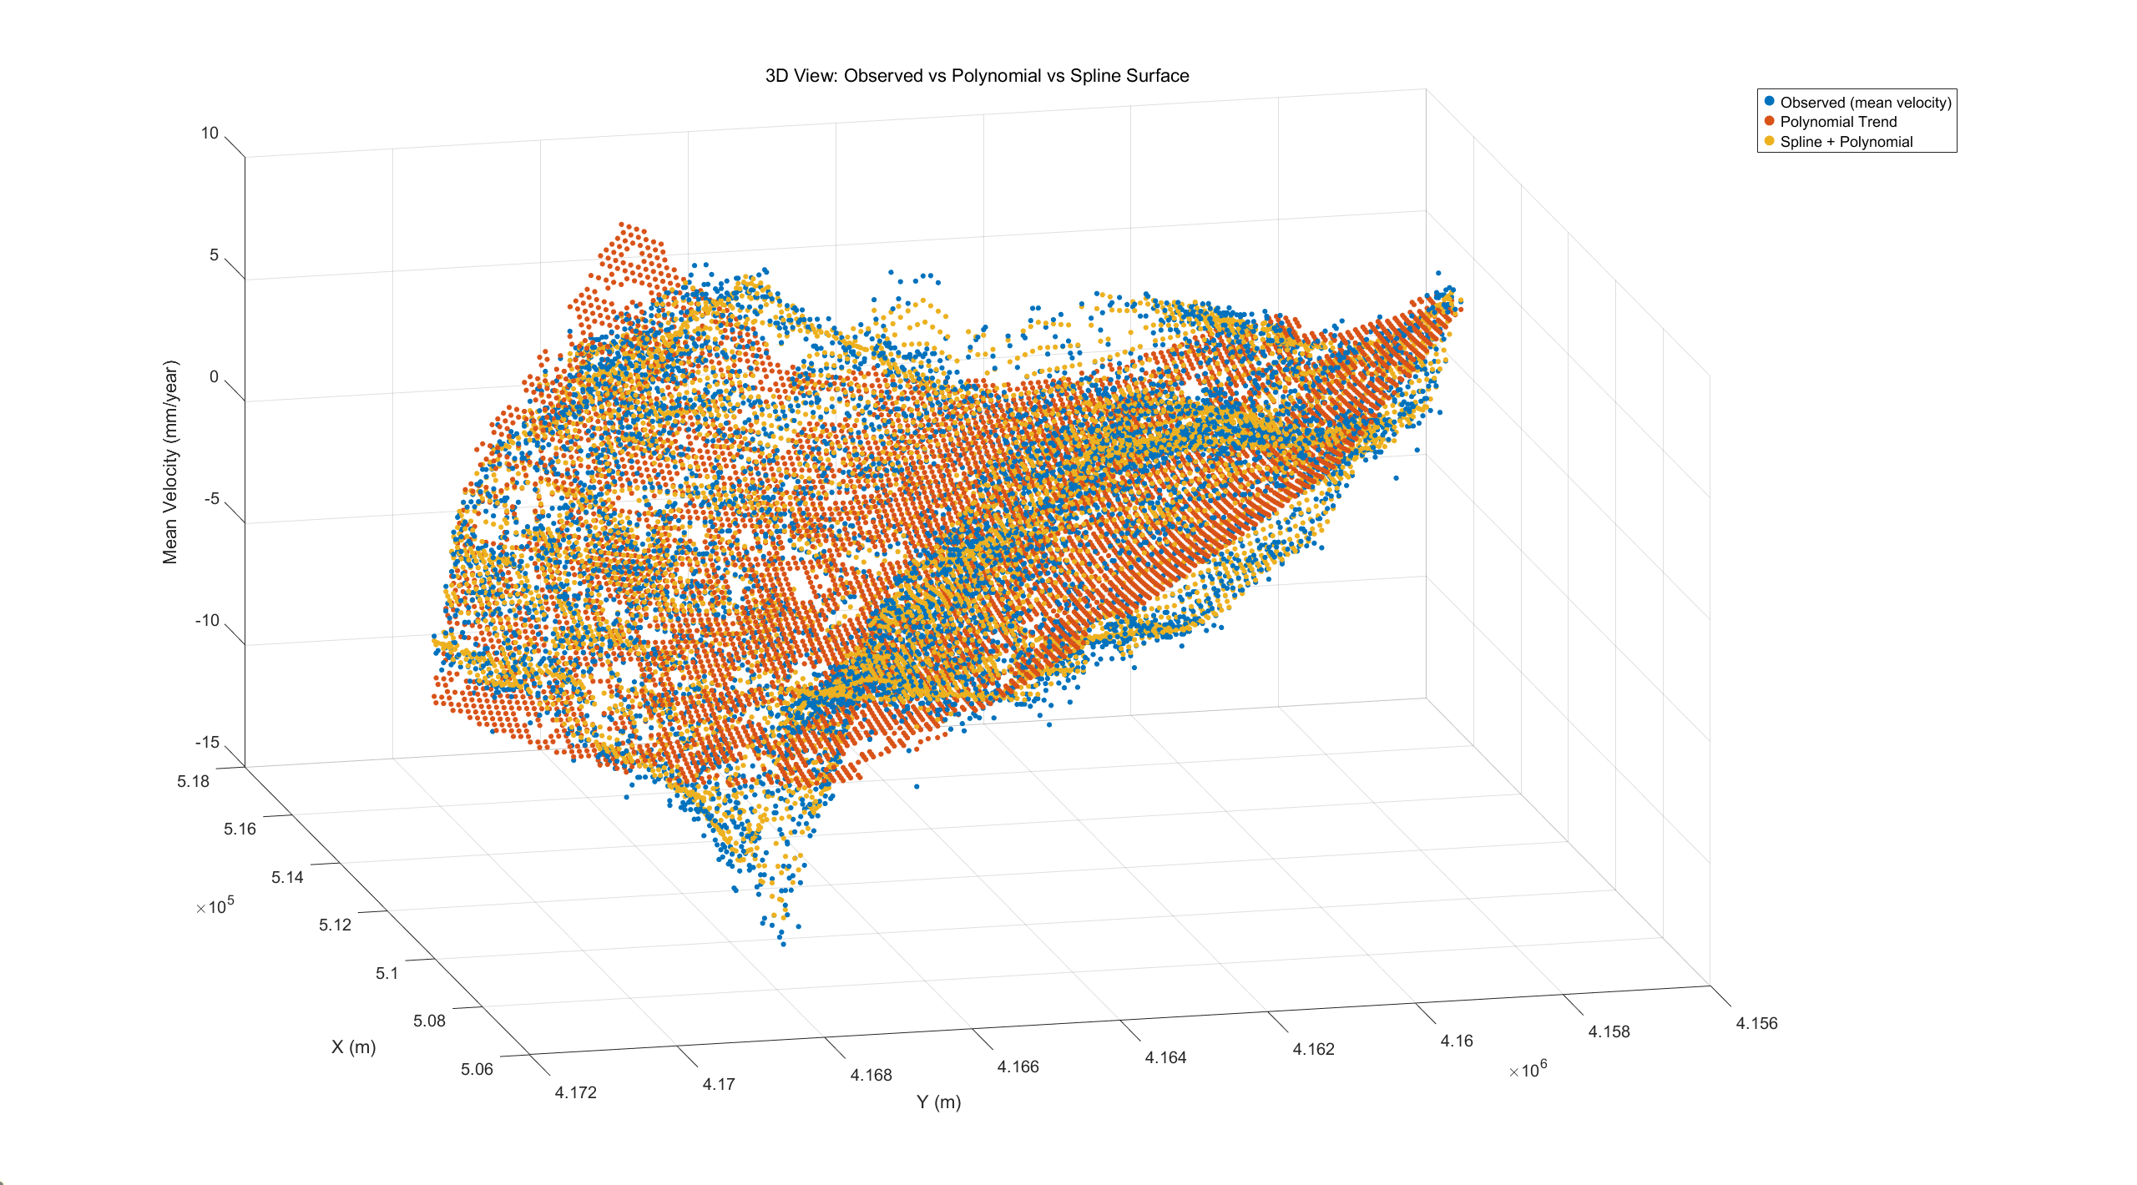
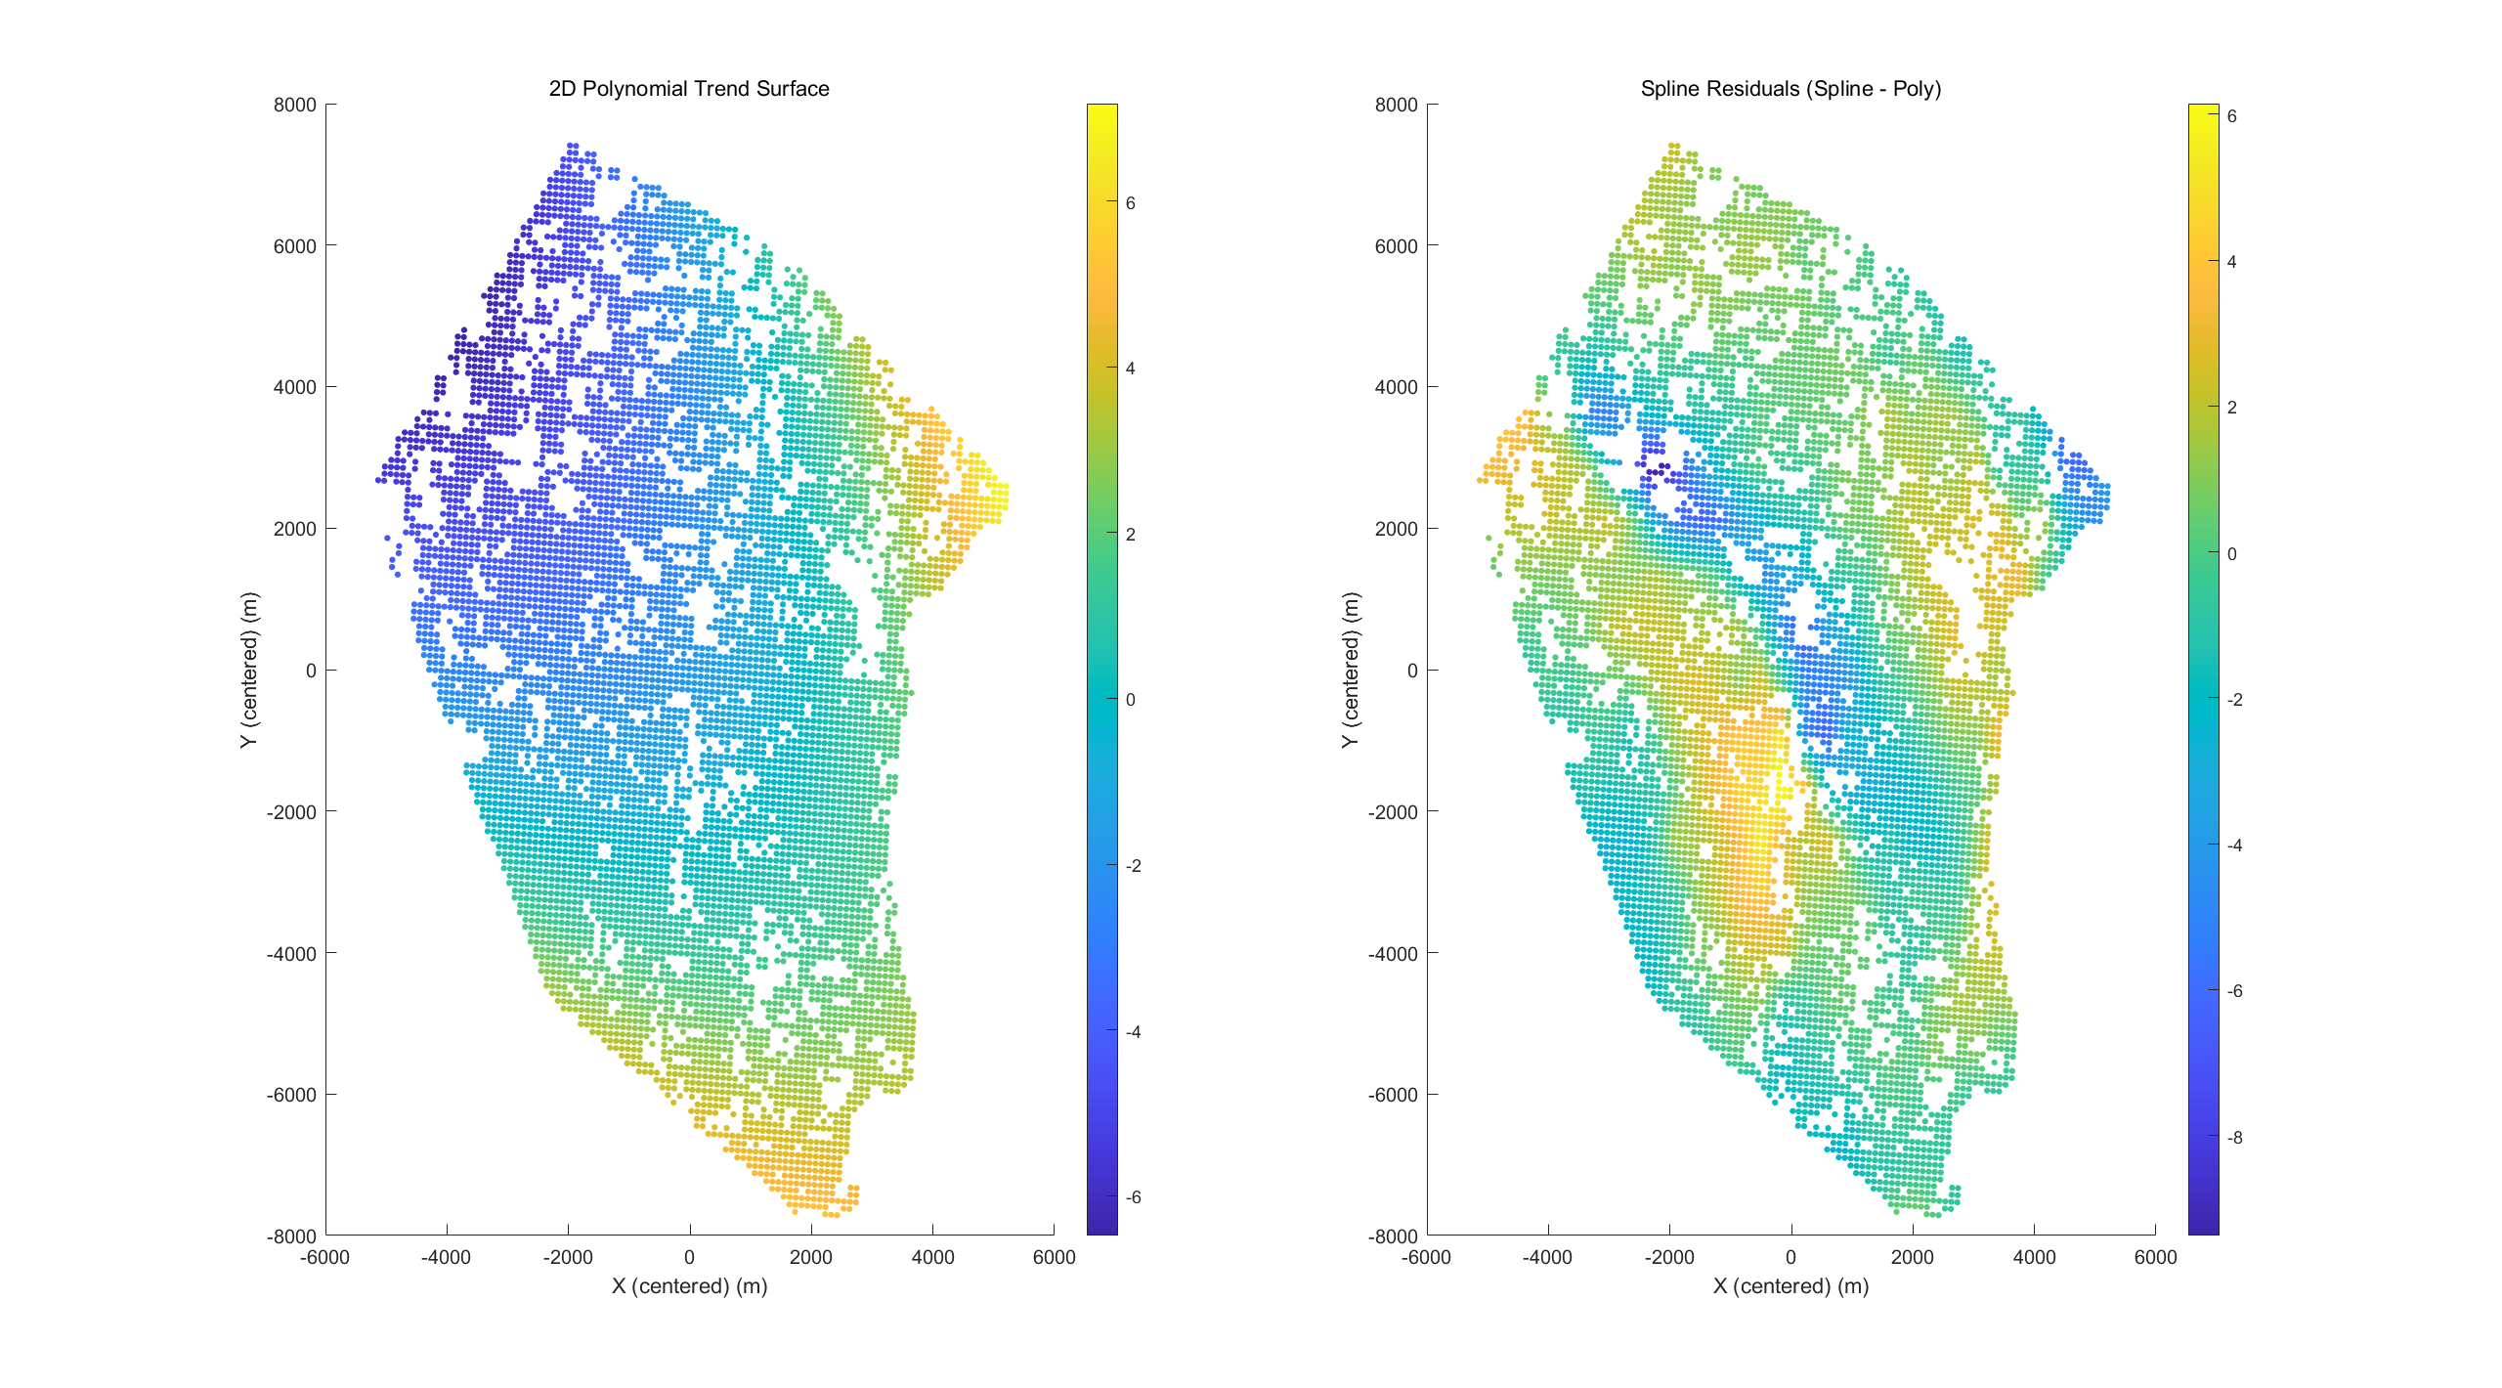
05 - Collocation Modeling (LSC)
Observed vs Polynomial vs Polynomial + Spline Surface
Quadratic trend captures the large-scale tilt/curvature.
Spline+trend follows fine, localized variations.
Fig.11 3D View: Observed vs Polynomial vs Spline Surface
Fig.12 Comparison between Polynomial & Polynomial + Spline
Notes:
Residuals show anisotropic, belt-like subsidence structures.
Global polynomials underfit these localized patterns.
Polynomial/Spline models primarily rely on regularization (λ) for smoothing, lacking an explicit noise model and providing no uncertainty.

Slide 15

05 - Collocation Modeling (LSC)
LSC Input
$$r=z−\text{poly}$$
Residuals are approximately zero-mean.
mean(residuals_poly) = -6.7076e-10
Spatial structure remains → assume a stationary random field over the area.
Fig.13 Residuals Distribution after Removal of Polynomial Trend
(after removal of outlier)
Notes:
I separate the signal into a global trend and a zero-mean residual field. LSC is applied to that residual to recover spatially correlated deformation while honoring measurement noise. LSC will model the stochastic residual $r=z−\text{poly}$ on top of the deterministic trend.
- These residuals are the input to covariance estimation.

Slide 16
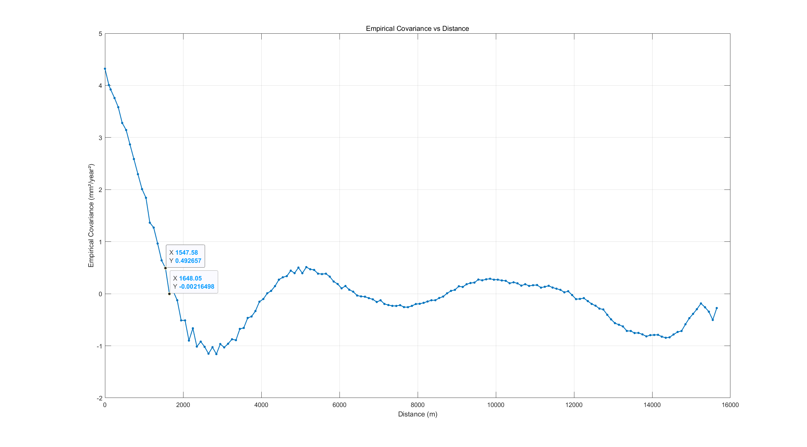
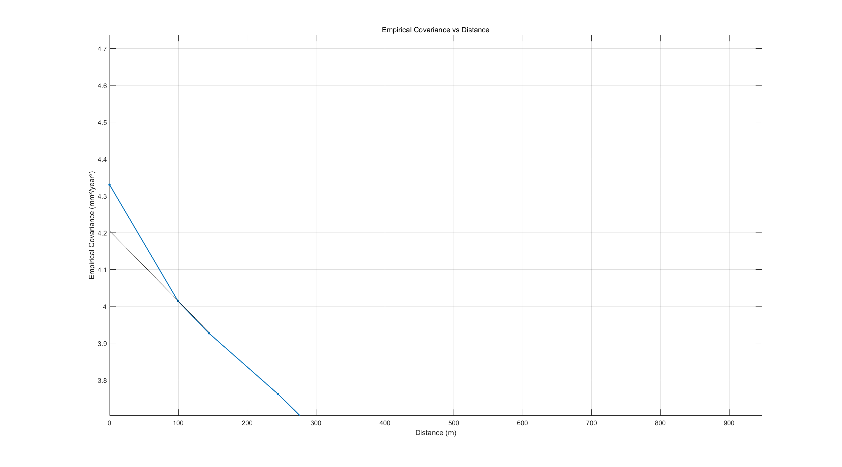
05 - Collocation Modeling (LSC)
Empirical Covariance Compute
Bin Size: 100m
Fig.14 Empirical Covariance vs Distance
Notes:
Bin all pairs by separation $τ$to get $\hat{C}\left(τ\right)$.
Near-origin covariance is high; clear correlation range; weak oscillation (cosine-like) visible.
Bin variances $\text{Cecf}$ provide weights for fitting
较高的自协方差（nugget）：$σ\left(0\right) about 4.3$mm²/year²。
快速下降趋势：在 $2000$m 内迅速降至接近 0，随后在 4000-12000 m 出现轻微震荡甚至小幅上升（可能是空间周期性或采样噪声造成的虚假相关性）
存在震荡趋势 → 建议加入正弦调制项（cos）

Slide 17
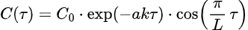
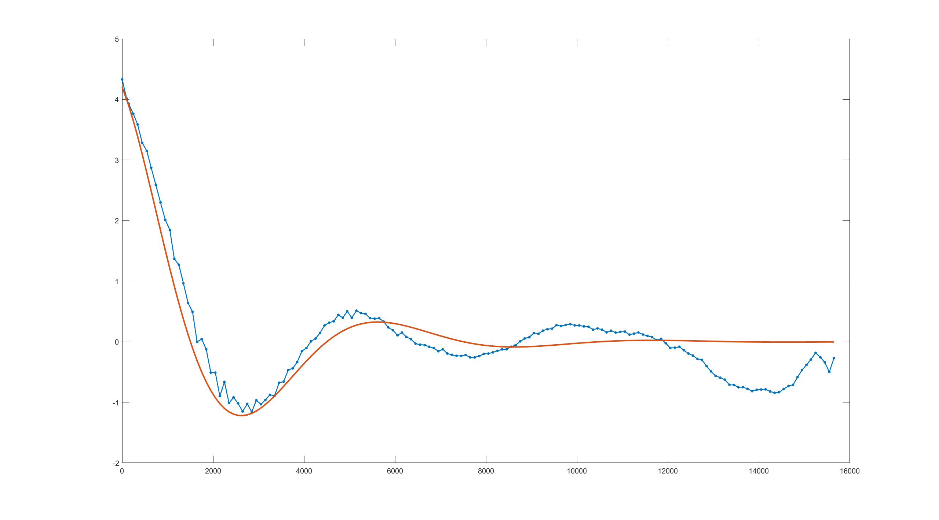
05 - Collocation Modeling (LSC)
Covariance Modelling
% Exponential model
% a parameter
a = ((log(eCovF(2))-log(eCovF(3)))/(sigmaGrid(3) - sigmaGrid(2)));
% k parameter
Q = diag(Cecf(2:17));
yo = log(eCovF(2:17)) - log(4.2) - log(cos(pi*sigmaGrid(2:17)/3000));
A = -a * sigmaGrid(2:17);
k = 0.9; % manual choice
fcove = @(tau) 4.2 * exp(-a * k * tau) .* cos(pi * 1/3000 * tau);
Nugget from Exponential modelling 0.3491
A-priori noise amplitude (std) 0.3000
Fig.15 Covariance modelling

Slide 18
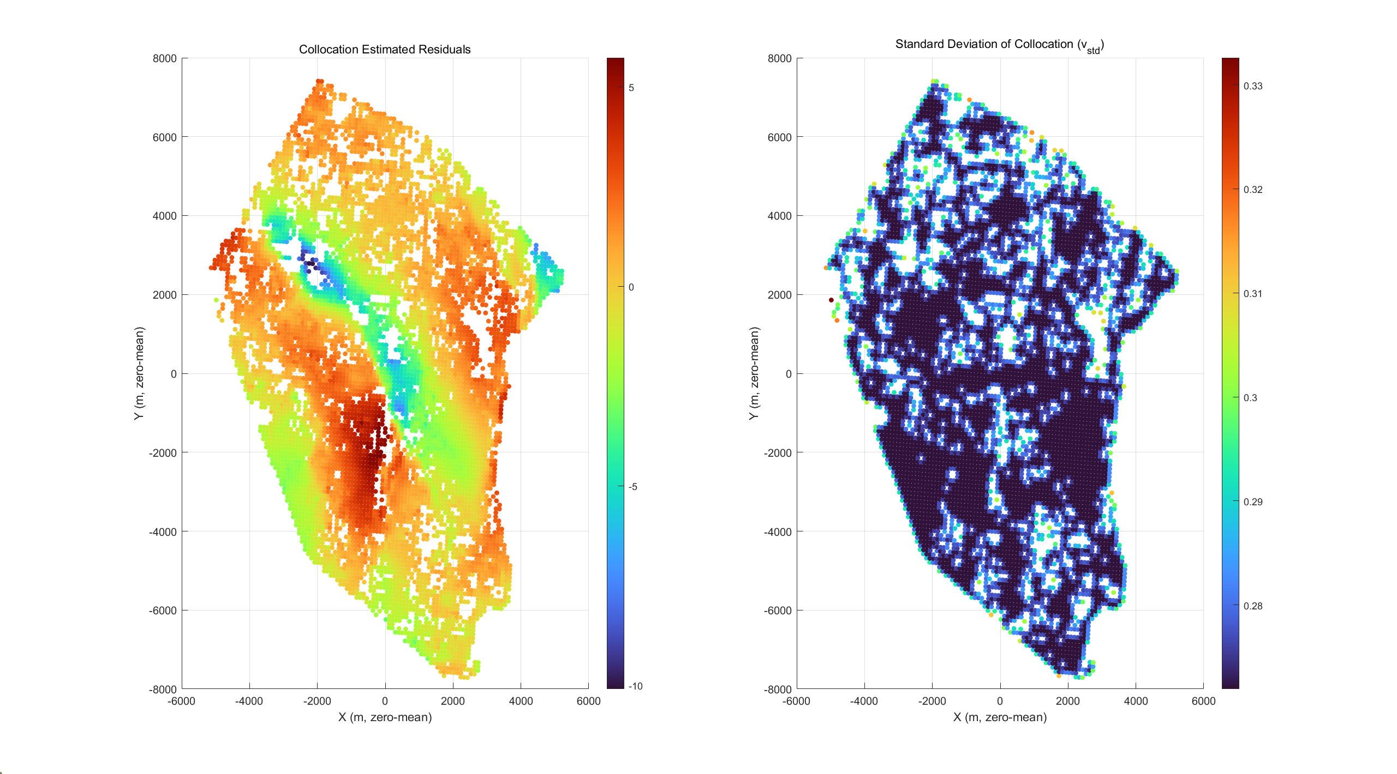
05 - Collocation Modeling (LSC)
Filtering
The optimal estimate of residuals at each PS point.
The banded subsidence pattern (central blue band) aligns with the spline/original residuals, indicating that the covariance model has incorporated this spatial correlation
Standard Deviation of Collocation
PS Dense, close to neighbors (within the relevant length)
→ 𝜎 smaller
Boundary/void areas (few neighbors, geometry skewed to one side)
→ 𝜎 larger
v_std: mean = 0.276 (mm/yr)
Fig.16 Collocation Estimated Residuals
Fig.17 Standard Deviation of Collocation
Notes:
BLUE estimate at observations

Slide 19
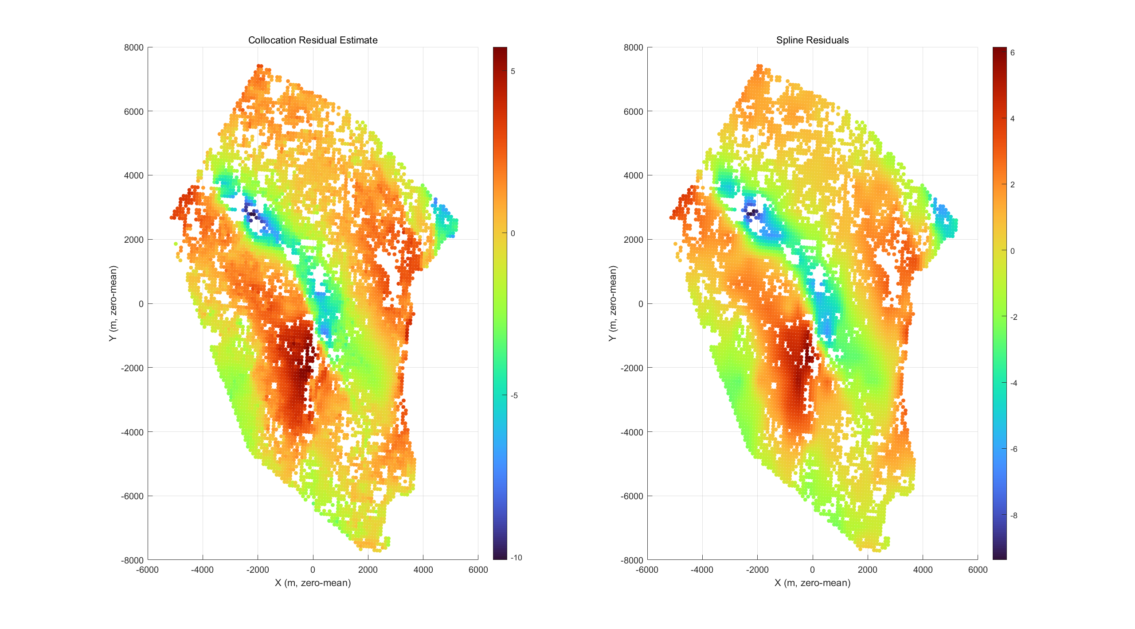
05 - Collocation Modeling (LSC)
Filtering vs Spline: Residual
Both recover the same main subsidence belt
Filtering:
mean –0.000,
std 2.042
RMS 2.046 mm/yr
Spline residual:
mean +0.076,
std 2.005,
RMS 2.007 mm/yr
Collocation Residual Estimates
Short correlation length + small nugget ⇒ very local weighting
Less smoothing than spline; steeper gradients, especially near edges/gaps
Spline
global regularization (λ, sparse nodes) ⇒ smoother, amplitude shrinks
Fig.18 Collocation vs Spline
Notes:
检验 两种方法是否得到一致的小尺度结构
我这里的协方差模型给了较短的相关长度和不大的 nugget，LSC 在点上就更“相信”局部观测、影响半径小，所以颜色变化更陡；而样条因为 λ 正则更强、节点更稀，看起来更顺滑。如果把相关长度调长或增大 nugget，LSC 的视觉效果会收敛到样条，但它的优势是能同时给出与协方差一致的不确定度。

Slide 20
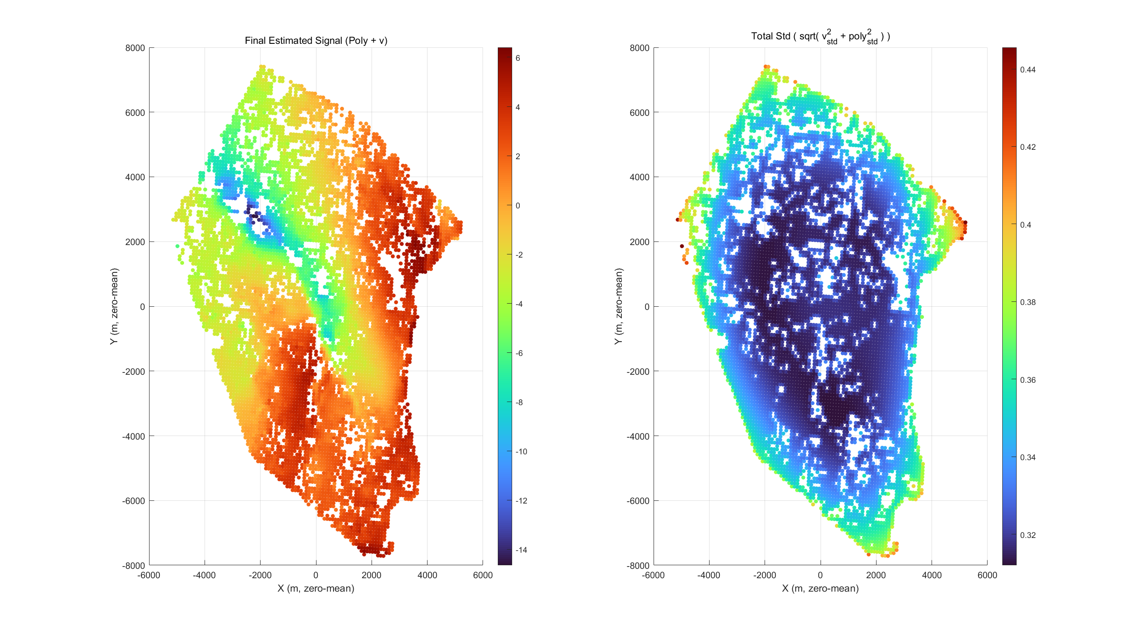
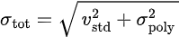
05 - Collocation Modeling (LSC)
Final estimate: Polynomial + Collocation Residual
Final mean_velocity = polynomial trend + LSC residual
Unit: mm/yr
Reflecting large-scale trends and small-scale anomalies;
High consistency with spline + trend models, yet statistically optimal.
Uncertainty: low in the interior, high at the edges/voids
Fig.19 Final estimate & Total Estimated Error

Slide 21
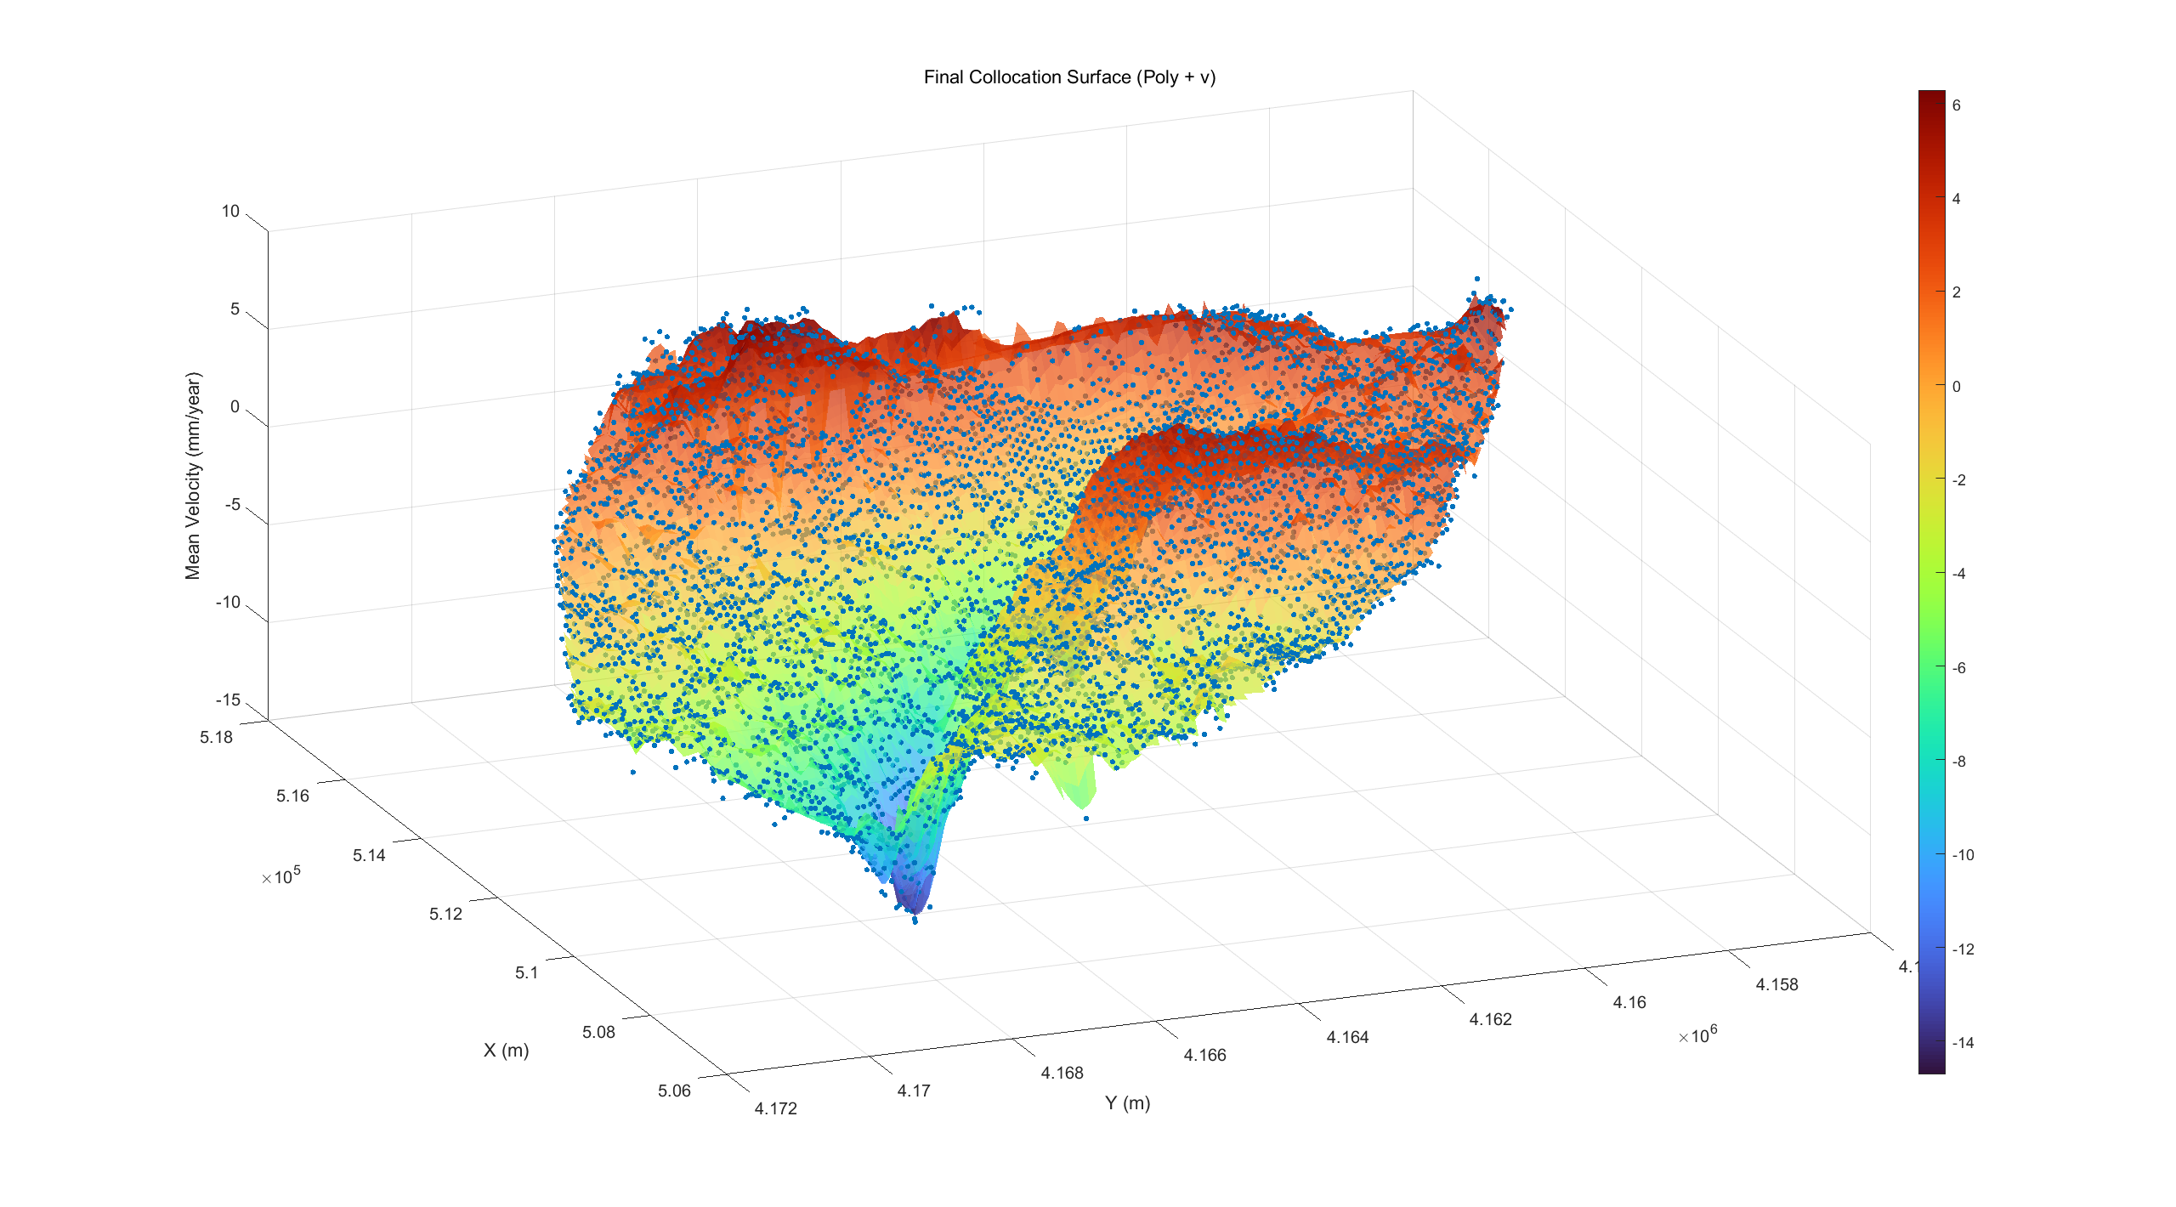
05 - Collocation Modeling (LSC)
Final estimate: Polynomial + Collocation Residual
Final mean_velocity = polynomial trend + LSC residual
Unit: mm/yr
Reflecting large-scale trends and small-scale anomalies;
High consistency with spline + trend models, yet statistically optimal.
Uncertainty: low in the interior, high at the edges/voids
Fig.20 3D View of residual estimates + poly

Slide 22
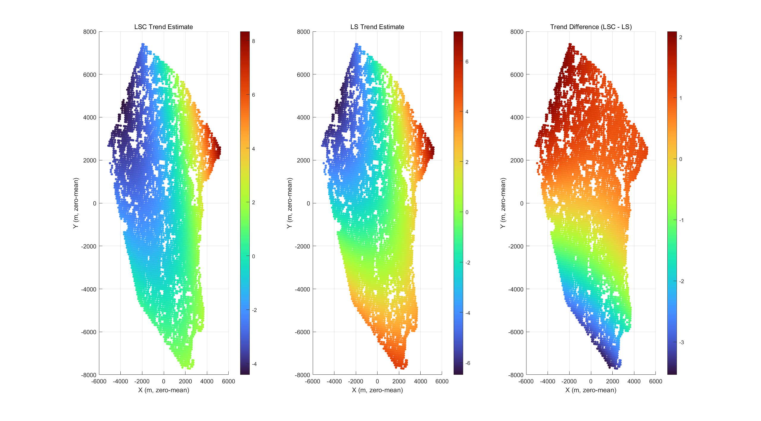
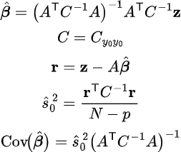
05 - Collocation Modeling (LSC)
Least Squares Collocation
T-test Significance
t-student test on the significance of the
estimated parameters (it. 0) - t_{lim}: 1.9603
Param. 1, t_{obs}: 3.0728
Param. 2, t_{obs}: 10.8959
Param. 3, t_{obs}: 2.5575
Param. 4, t_{obs}: 32.5903
Param. 5, t_{obs}: 8.4437
Param. 6, t_{obs}: 2.1198
diff_LSC_rms = 1.3204 mm/yr
Fig.21 Comparing the Global Trend Estimation
Notes:
The primary trends of both methods (slope/subsidence-uplift distribution from northwest to southeast) show high consistency, indicating that the quadratic polynomial is sufficient to characterize the long-wave morphology. Collocation incorporates spatial correlation and observational noise into weights: points with strong correlation or high noise are assigned lower weights.
Because the field contains a narrow, deep negative belt flanked by uplift (large amplitude, short wavelength), a global quadratic LS fit is forced to bend to explain it, while LSC—by design—splits the signal into a smooth deterministic trend and a correlated residual. With a (single-range, isotropic) covariance, LSC tends to absorb that sharp belt into the residual and keep the trend flatter, so the LSC − LS trend difference looks large
LSC 用 $W=\left(C+σ_{v}^{2}I{\left.)\right.}^{−1}\right.$给相关小/噪声小/密度高的区域更高权重；LS 假定独立同方差。
若点分布不均或某些区域噪声更小，GLS 会把长波趋势“拉向”这些高权区，与 LS 出现系统差。

Slide 23
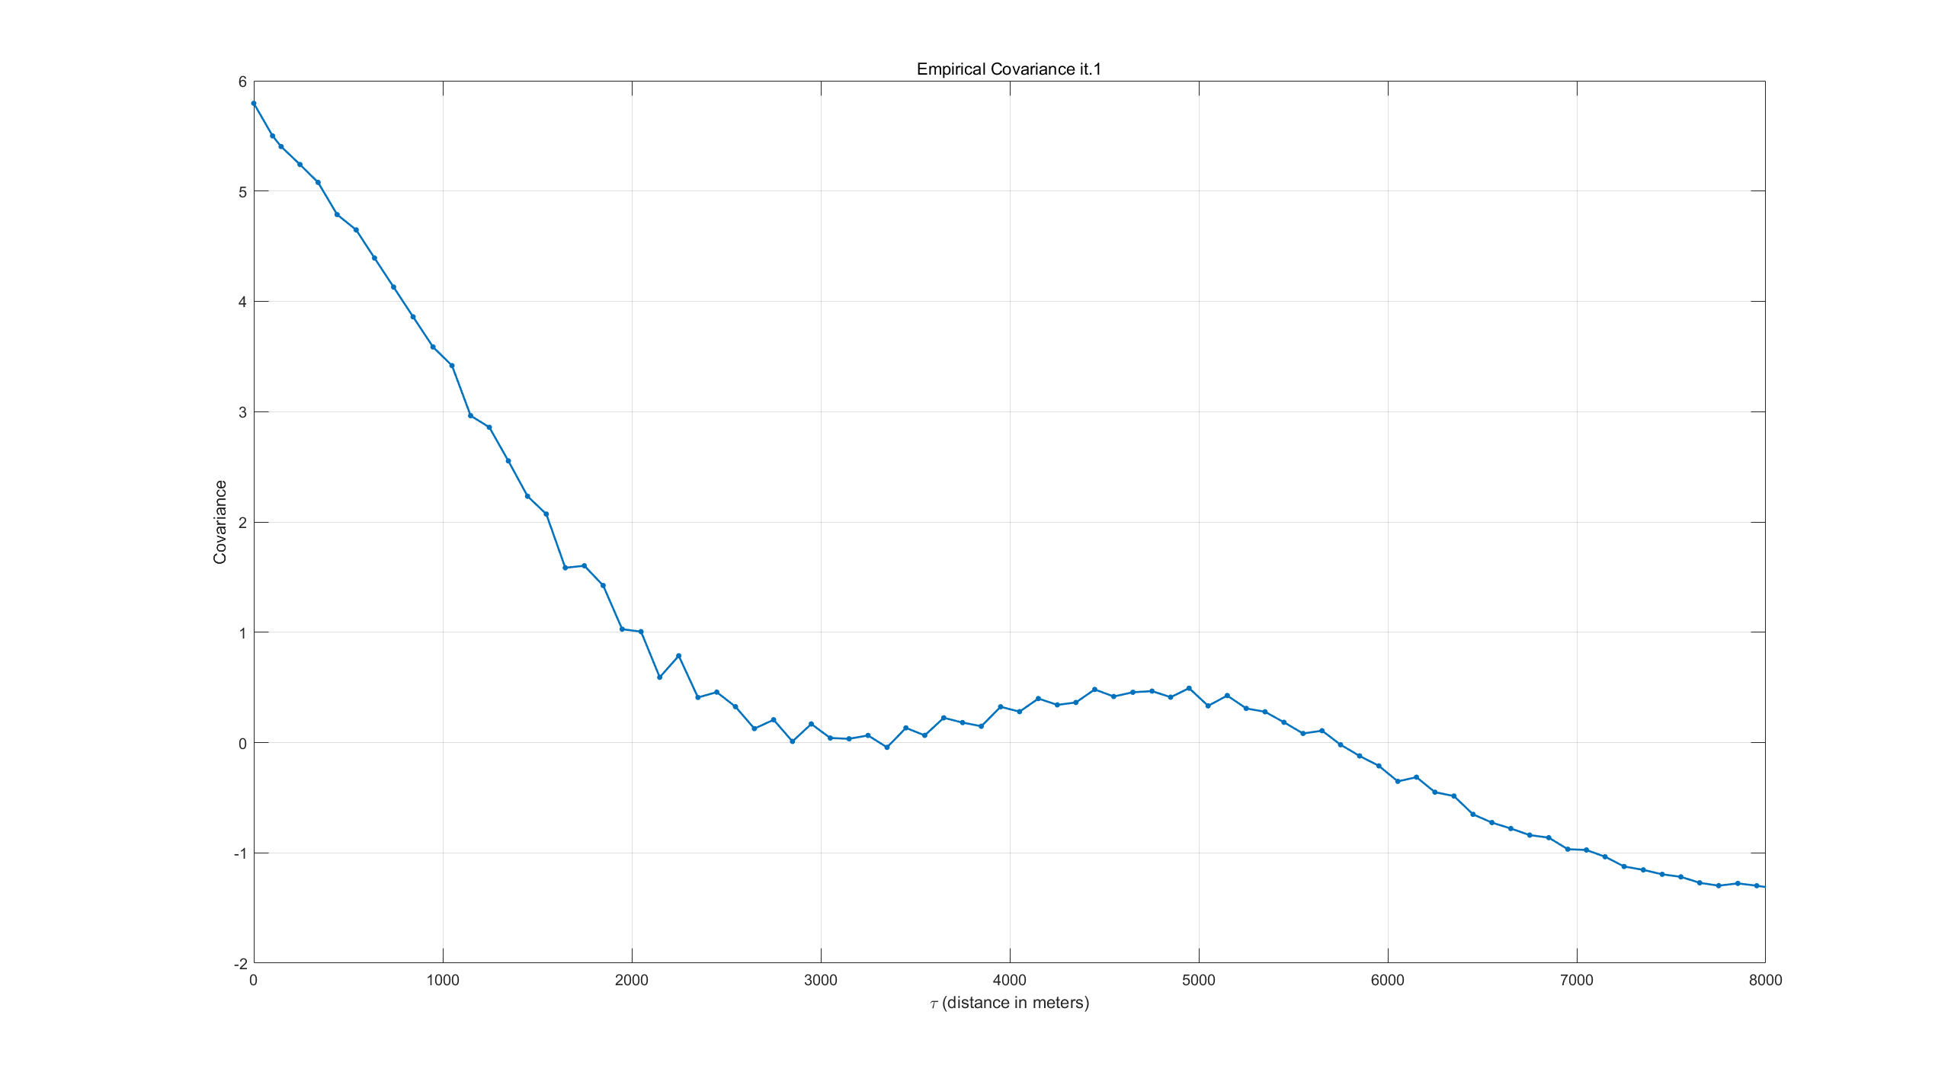
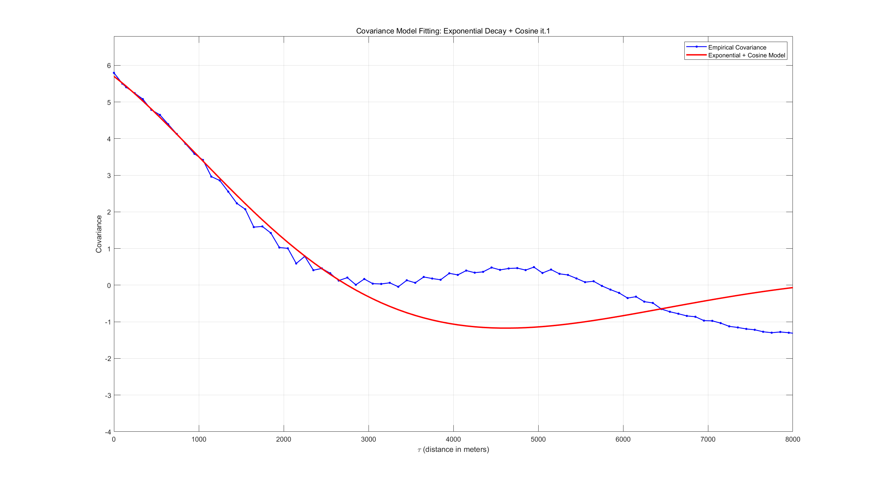
05 - Collocation Modeling (LSC)
Least Squares Collocation it.1
% Exponential model fit
a = ((log(eCovF(2))-log(eCovF(3)))/(sigmaGrid(3) - sigmaGrid(2)));
k = 0.8; % reduce k
fcovLSC = @(tau) 5.7 * exp(-a * k * tau) .* cos(pi * 1/5500 * tau); % enlarge the periods
s2v_LSC = eCovF(1) - fcovLSC(0);
Nugget from Exponential modelling 0.3094
A-priori noise amplitude (std) 0.3000
Fig.22 Covariance Model Fit

Slide 24
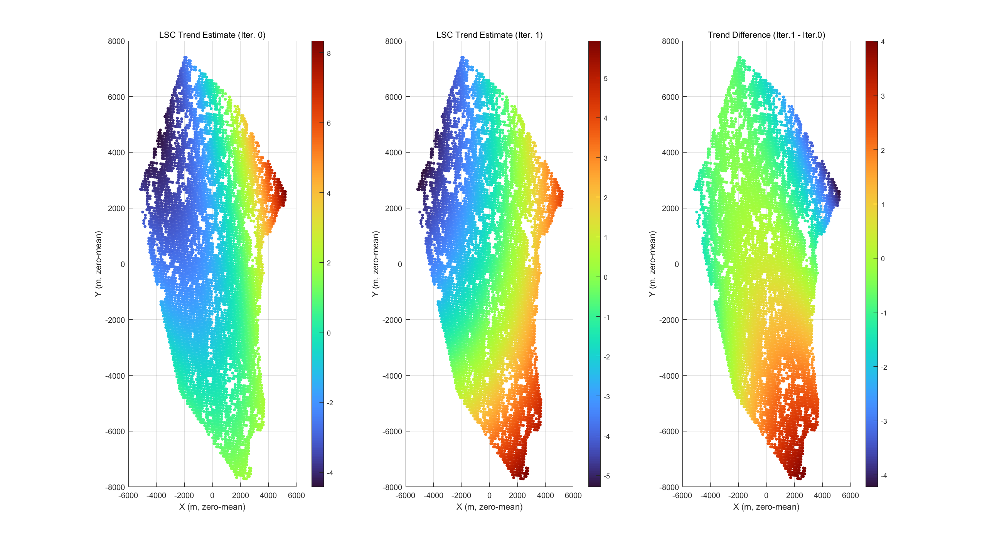
05 - Collocation Modeling (LSC)
Least Squares Collocation it.1
Fig.23 LSC Estimates Comparing
Notes:
The primary trends of both methods (slope/subsidence-uplift distribution from northwest to southeast) show high consistency, indicating that the quadratic polynomial is sufficient to characterize the long-wave morphology. Collocation incorporates spatial correlation and observational noise into weights: points with strong correlation or high noise are assigned lower weights.
Because the field contains a narrow, deep negative belt flanked by uplift (large amplitude, short wavelength), a global quadratic LS fit is forced to bend to explain it, while LSC—by design—splits the signal into a smooth deterministic trend and a correlated residual. With a (single-range, isotropic) covariance, LSC tends to absorb that sharp belt into the residual and keep the trend flatter, so the LSC − LS trend difference looks large

Slide 25
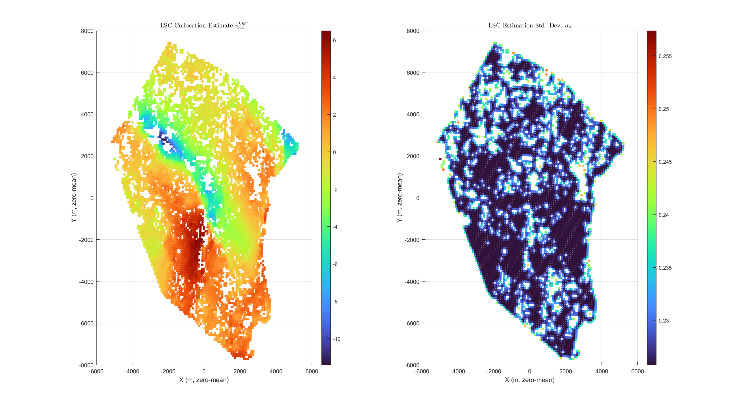
05 - Collocation Modeling (LSC)
Least Squares Collocation it.1
Fig.24 Final LSC Estimates and Error Variance

Slide 26
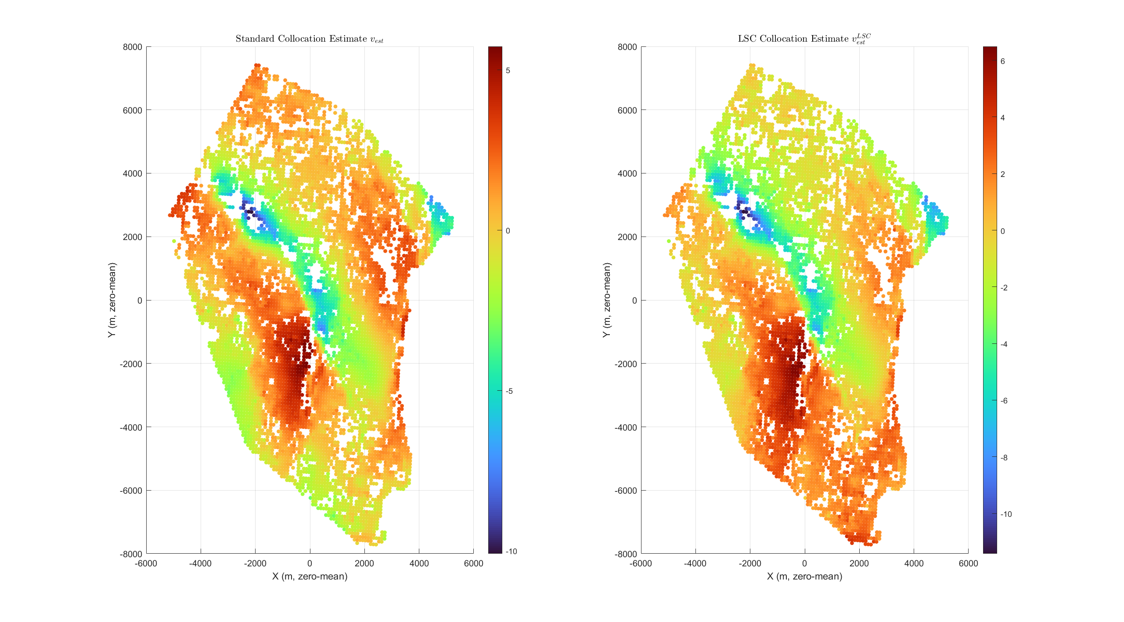
06 - Model Evaluation and Interpretation
Fig.25 Comparison the OLS with LSC

Slide 27
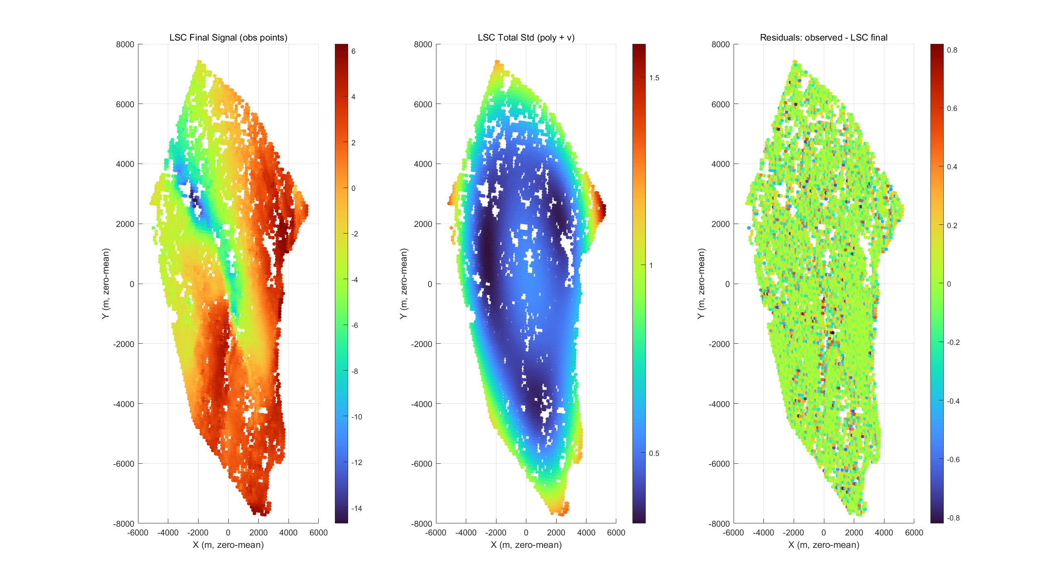
06 - Model Evaluation and Interpretation
Residuals to observed mean-vel:
mean=0.000
std=0.176
RMS=0.176 (mm/yr)
Fig.26 Final LSC interpolation with uncertainty

Slide 28
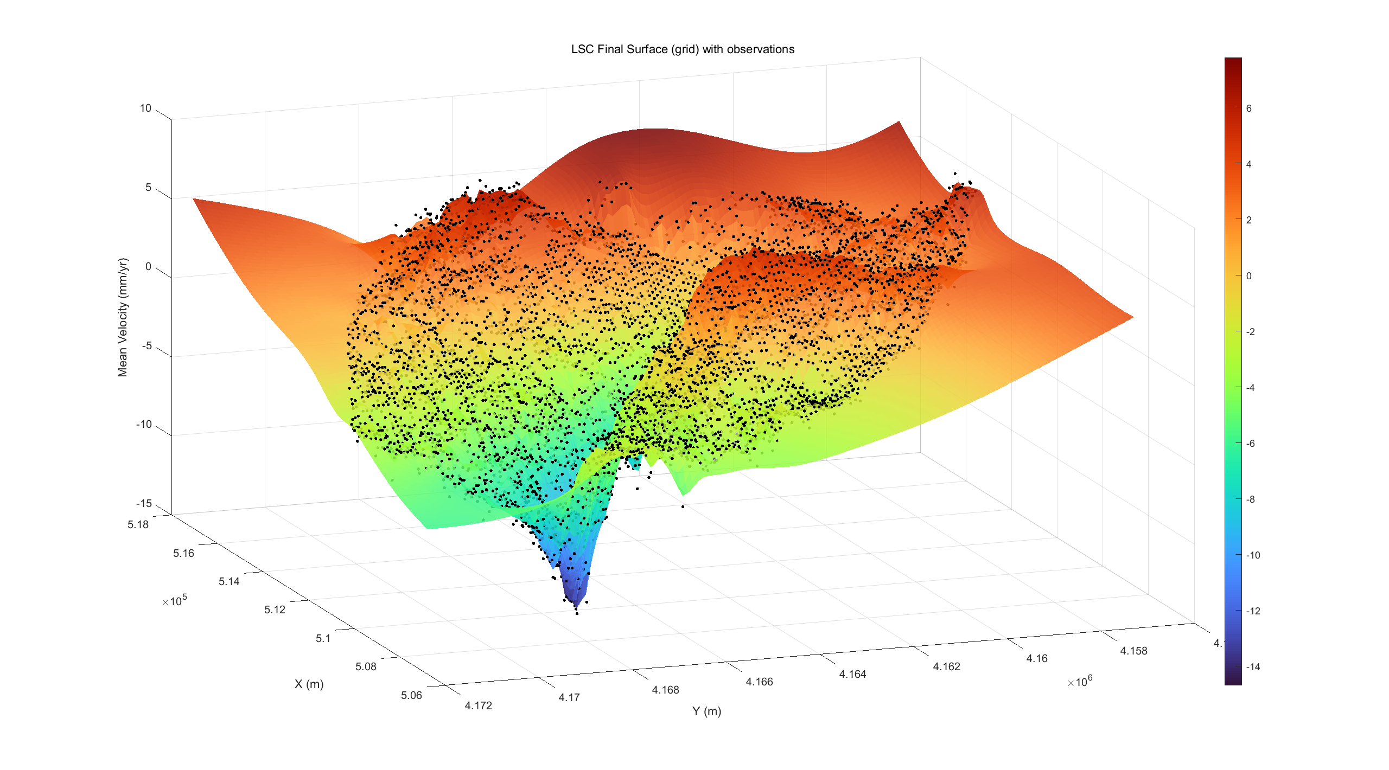
06 - Model Evaluation and Interpretation
Fig.27 3D - Final LSC interpolation

Slide 29
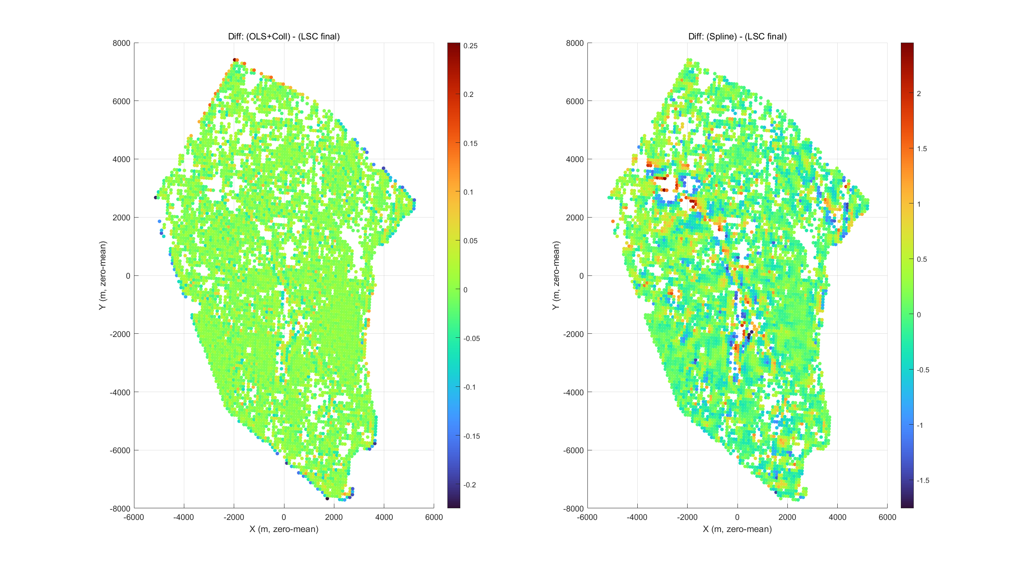
06 - Model Evaluation and Interpretation
Compare to Spline: LSC is smoother under the constraints of the covariance model. Differences are often concentrated in sparse data areas, edges, or directions with significant anisotropy.
Fig.26 Final LSC interpolation with uncertainty
Notes:
与 OLS+Collocation 的比较
相关系数 = 1.000（几乎完全重合），RMS 差值仅 0.028 mm/yr；
最大差异也只有 0.25 mm/yr。 说明 在观测点域上，标准 Collocation 和 LSC 的结果几乎一样，差别仅在加权矩阵对多项式估计的微调。
与 Spline 的比较
相关系数 = 0.993，非常高；
RMS 差值 = 0.416 mm/yr，比前一个稍大；
最大差值约 2.45 mm/yr，说明局部可能有些差异（比如边缘或数据稀疏区）。 Spline 更自由地拟合局部变化，而 LSC 是在协方差模型约束下的平滑估计，所以局部有些差异是预期的

